Slide 1
TBM Taxonomy
Version 4.0 DRAFT
Date: December 15, 2020

Slide 2
Table of Contents
Introduction to TBM Taxonomy
TBM Taxonomy v4.0
TBM Taxonomy v4.0 Annotated
Appendix: Conceptual TBM Models
IMPORTANT NOTICE: This document is in draft form and is shared for community review and feedback. It is subject to change without notice.
Please contact us at standards@tbmcouncil.org with any feedback.
We anticipate approving and publishing the final v4.0 taxonomy in December 2020.

Slide 3
Introduction to TBM Taxonomy

Slide 4
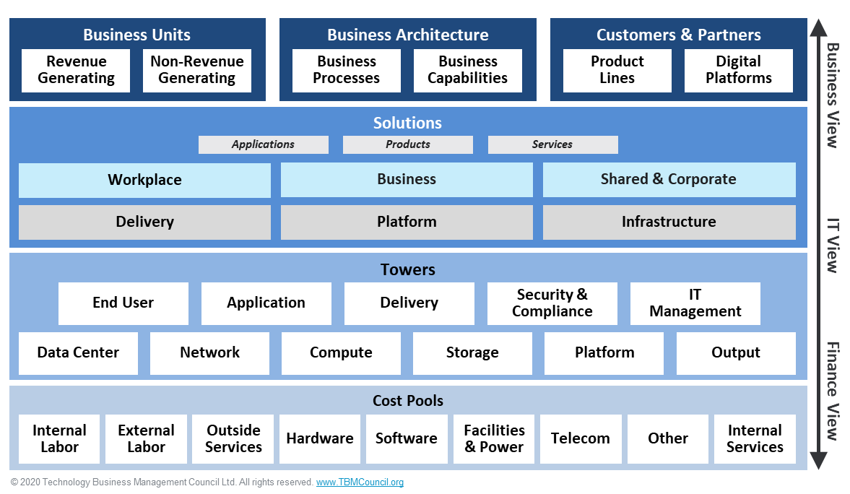
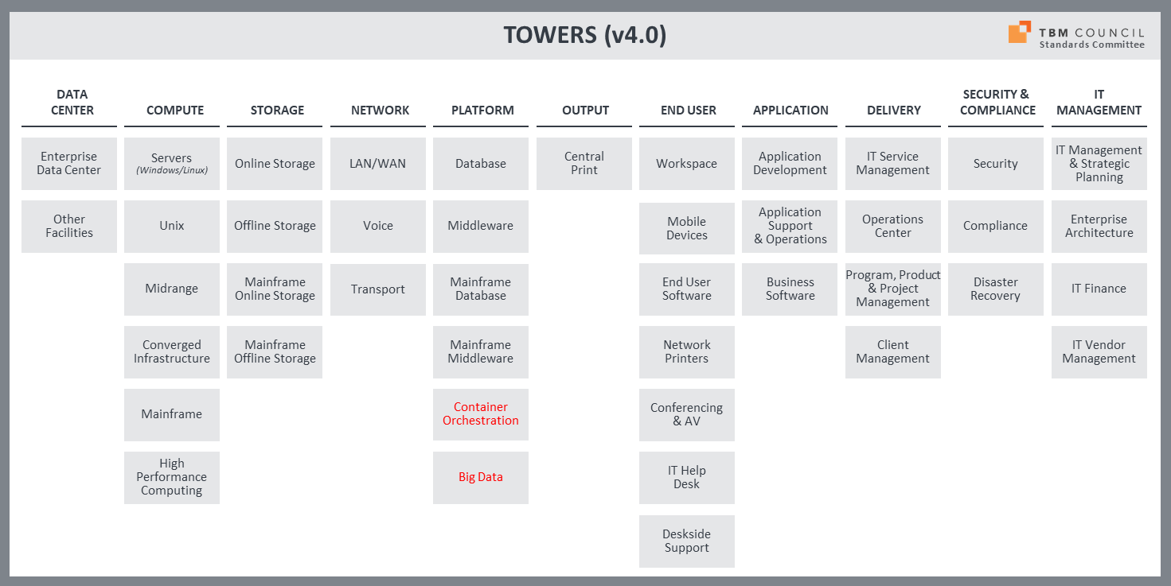
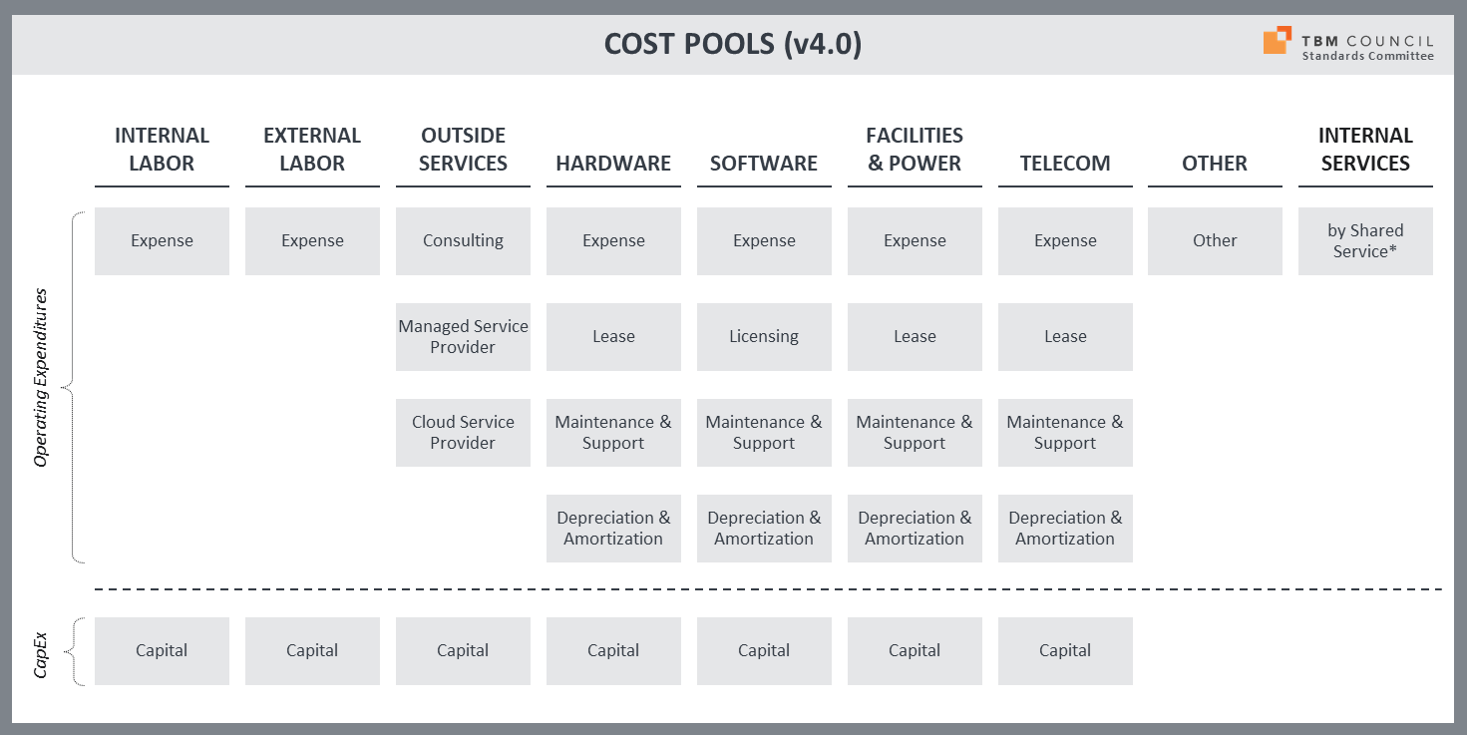
Why a Taxonomy?
Problems taxonomy aims to solve:
Accelerate implementations of TBM models / software
Align data from multiple tools (e.g., CMDB, SAM, ITSM, etc.)
Align people on a common vocabulary
Relate different perspectives – finance, IT/tech and line-of-business
Influence industry adoption of TBM principles, best practices and tools

Slide 5
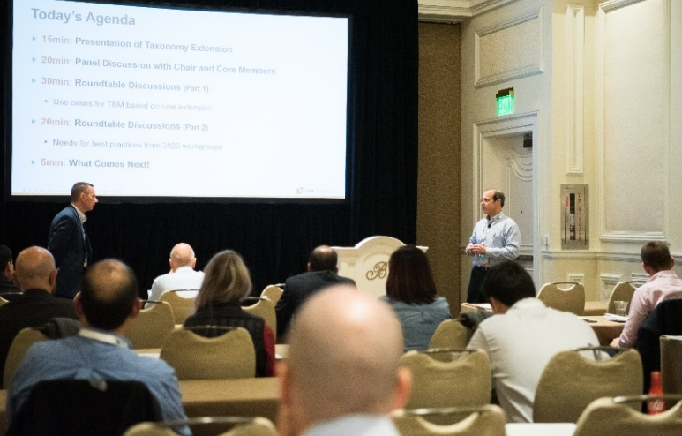
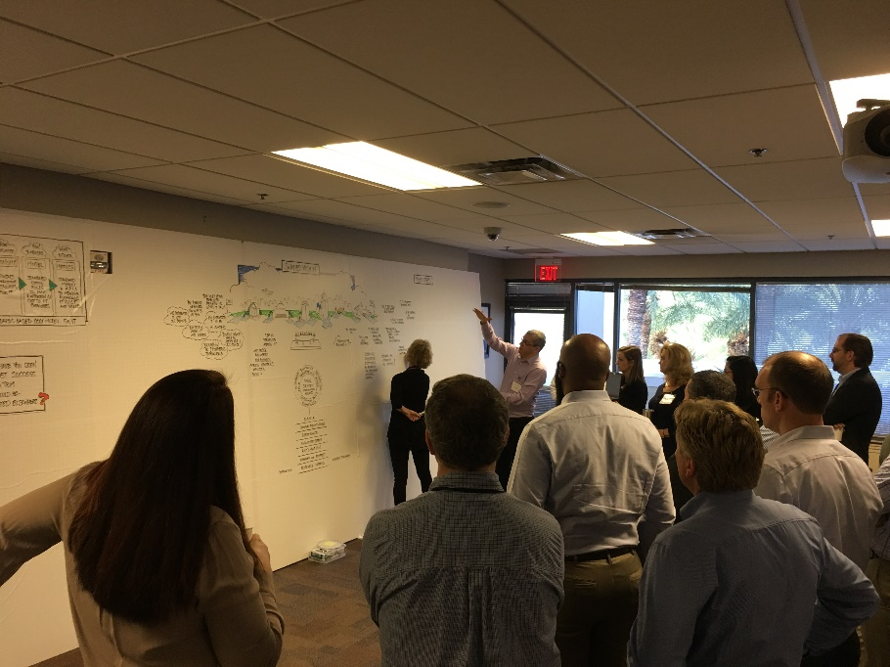
Who Uses the Taxonomy?
TBM program professionals to must build and maintain a TBM cost model based on standards
IT financial managers who support technology cost modeling and reporting
CIOs and I&O leaders when explaining the composition and drivers of technology costs
Enterprise architects interested in service composition, consumption and costs
CFOs and their teams who deal with business unit cost allocations, chargebacks, and budget authority for tech spending
Owners of products, services, apps and other solutions who are accountable for TCO

Slide 6
TBM Taxonomy v4.0

Slide 7
TBM Taxonomy V4.0 DRAFT (High Level View)
Standards Committee
Business Units
Business Architecture
Customers & Partners
Revenue Generating
Non-Revenue Generating
Business Processes
Business Capabilities
Product
Lines
Digital Platforms
Solutions
Applications
Products
Services
Workplace
Business
Shared & Corporate
Delivery
Platform
Infrastructure
Business View
IT View
Finance View
Towers
End User
Application
Delivery
Security & Compliance
IT Management
Data Center
Network
Compute
Storage
Platform
Output
Cost Pools
Internal Labor
External Labor
Outside Services
Hardware
Software
Facilities & Power
Telecom
Other
Internal Services
© 2020 Technology Business Management Council Ltd. All rights reserved. www.TBMCouncil.org

Slide 8
COST POOLS (v4.0)
Standards Committee
INTERNAL LABOR
EXTERNAL LABOR
OUTSIDE
SERVICES
HARDWARE
SOFTWARE
FACILITIES
& POWER
TELECOM
OTHER
INTERNAL SERVICES
Expense
Expense
Consulting
Expense
Expense
Expense
Expense
Other
by Shared
Service*
Managed Service Provider
Lease
Licensing
Lease
Lease
Operating Expenditures
Cloud Service Provider
Maintenance & Support
Maintenance & Support
Maintenance & Support
Maintenance & Support
Depreciation & Amortization
Depreciation & Amortization
Depreciation & Amortization
Depreciation & Amortization
CapEx
Capital
Capital
Capital
Capital
Capital
Capital
Capital

Slide 9
TOWERS (v4.0)
Standards Committee
DATA
CENTER
COMPUTE
STORAGE
NETWORK
PLATFORM
OUTPUT
END USER
APPLICATION
DELIVERY
SECURITY &
COMPLIANCE
IT
MANAGEMENT
Enterprise
Data Center
Servers
Online Storage
LAN/WAN
Database
Central
Print
Workspace
Application Development
IT Service
Management
Security
IT Management & Strategic Planning
Other
Facilities
Unix
Offline Storage
Voice
Middleware
Mobile
Devices
Application Support
& Operations
Operations
Center
Compliance
Enterprise Architecture
Midrange
Mainframe
Online Storage
Transport
Mainframe Database
End User Software
Business Software
Program, Product
& Project Management
Disaster Recovery
IT Finance
Converged Infrastructure
Mainframe
Offline Storage
Mainframe Middleware
Network
Printers
Client
Management
IT Vendor
Management
Mainframe
Container Orchestration
Conferencing
& AV
High Performance Computing
Big Data
IT Help
Desk
Deskside
Support

Slide 10
TOWERS (v4.0)
Standards Committee
Hierarchy
Tower
Sub-Tower
Sub-Tower Element
Example
Compute
Servers
Windows
Linux
Standardized TBM Taxonomy
Optional for more granular aggregation and allocation

Slide 11
SOLUTIONS (v4.0)
Standards Committee
Applications
Products
Services
Workplace
Workplace solutions include the client computing devices, software and connectivity to enable the workforce to access business applications; to communicate with other employees, partners and customers; and to create content using productivity software.
These are always “user-facing” solutions.
Business
Business solutions are delivered by IT to enable product and external customer focused business capabilities that enable the business to win, serve, and retain customers.
Shared & Corporate
Shared & Corporate solutions are delivered by IT to enable internally focused corporate services which automate and support the organization’s internal operations. These are often referred to as business support or shared services which enable the core operating capabilities of an enterprise or organization (e.g. Finance, Human Resources, Legal, etc.).
Delivery
Delivery solutions are those to build, deploy, support, and operate the Workplace solutions, Business solutions, and Shared & Corporate solutions. Development services create and change business-facing services, typically through projects. Additional support and operations services assist users and ensure the availability of the business-facing services.
Platform
Platform solutions include the application infrastructure (database, middleware, etc.) that enables business-facing applications and services. Typically, these are not directly consumed by users. They are components required by the end user, business application and shared application services (see below for the latter two types). However, for some IT operating models, the shared “infrastructure and operations group” may directly provide these Platform Services to their customers.
Infrastructure
Infrastructure solutions include the core infrastructure — facilities, compute, storage and network services — that are required to deliver any technology automation. Typically, these are not directly consumed by users. However, for some IT operating models, a shared “infrastructure and operations group” may directly provide these Infrastructure Services to their customers. .

Slide 12
SOLUTIONS (v4.0)
Standards Committee
Applications
Products
Services
Workplace
Business
Shared & Corporate
Client Computing
Communication & Collaboration
Product Management
Sales & Marketing
Finance
Workforce
Connectivity
Manufacturing & Delivery
Customer Service
Vendor & Procurement
Health, Safety, Security & Environmental
Or
Risk, Audit & Compliance
Legal
Industry specific solutions to win, serve and retain customers
Property & Facility
Corporate Communications
Delivery
Platform
Infrastructure
Strategy & Planning
Development
Application
Data
Data Center
Network
Support
Operations
Compute
Storage
Security & Compliance

Slide 13
SOLUTIONS (v4.0)
Standards Committee
Hierarchy
Type
Category
Name
Offering
Example
Infrastructure
Compute
Virtual Compute & Containers
Xen, OpenStack, VMware (on-prem)
AWS/Azure/GCP offerings
Standardized TBM Taxonomy
Organization-specific modifications

Slide 14
SOLUTIONS (v4.0)
Standards Committee
Delivery
Strategy & Planning
Technology Business Management
IT Planning
IT Finance & Costing
IT Billing
Business Value
Metrics & Benchmarking
Strategy Management (new)
Service Portfolio management
Service Catalog management
Service Level management
Availability management
Innovation & Ideation
New technology solutions
Incubation services
Enterprise Architecture
Business architecture
Information architecture
Application architecture
Infrastructure architecture
Program, Product & Project Management
Portfolio investment planning
Project planning & delivery
Continuous planning & delivery
Business Solution Consulting
Business Relationship management
Business Process analysis
Technology solution analysis
Demand management
IT Vendor Management
Vendor Selection / Negotiation
Procurement
Development
Design & Development
Custom build
Package configuration
SaaS configuration
System Integration
On-prem application integration
SaaS integration
Modernization & Migration
App re-architecture
Data migration
Infra re-architecture
Testing
Functional testing
Integration testing
Performance testing
Usability testing
Support
Service Desk
Central help desk
Deskside support
Tech bar support
IT knowledge management
Request fulfillment
Application Support
Tier 2 app support (by app)
Tier 3 app support
IT Training
Off-the-shelf productivity training
Business application training
Central Print
Bill/invoice print
Publications
Automated post processing
Operations
IT Service Management
Incident management
Problem management
Change management
Asset management (CMDB)
Event Management
Network monitoring
System monitoring
Application monitoring
Usage analytics
Logging analytics
Scheduling
Batch processing
Capacity Management
Storage capacity
Compute capacity
Data Center capacity
Deployment & Administration
Software distribution
Config administration
Patch management
Security & Compliance
Identity & Access Management
Authentication/Authorization
Identity Management
Identity Governance & Administration
Privileged Access Management
Certificate Management
Security Awareness
Security Training
Security Advisory
Security Policies and procedures
Cyber Security & Incident Response
Cyber Security Monitoring
Security Incident Response
Threat & Vulnerability Management
Application Vulnerability Management
Infrastructure Vulnerability Management
Network/Endpoint Security
Data Privacy & Security
Data Classification & identification
Data loss prevention
Data encryption
Database security
Governance, Risk & Compliance
Risk management
Policy management
Policy tracking
Data governance
Business Continuity & Disaster Recovery
Business continuity policies
Business resiliency plans
DR procedures & exercises
DR facilities
Office continuity facilities
NOTE: Italicized sub-entries under Solution names are representative (example) offerings. They are not to be considered standard offerings. They are used to illustrate the types of offerings or commercial products that often comprise a specific Solution.

Slide 15
SOLUTIONS (v4.0)
Standards Committee
Platform
Data
Application
Analytic Services
Analytic Services
Database
Relational Database
Oracle DBMS
Microsoft SQL, RDS
Azure SQL Database
Non Relational database
Oracle NoSQL
MongoDB, Hadoop
Amazon DynamoDB
Azure DocumentDB
Distributed Cache
Amazon ElasticCache
Azure Redis Cache
Data Management
Extract, transform & load (ETL)
Data Quality
Data Cleansing
Master Data Management
Data Warehouse
Central data warehouse
Operational data stores
Teradata
Amazon Redshift
Asure Data Warehouse, Data Catalog
Data Analytics & Visualizations
Visual UI / BI tools
Geospatial analytics
Stream analytics
AWS Kinesis
Azure Stream Analytics
Application Hosting
Web Services
WebSphere, Tomcat
Azure App Service, Cloud Service
Development Platform
Integrated development platform
IoT services
Ecommerce services
Foundation Platform
ERP Administration platform
SaaS development platforms
SAP Basis
Oracle Cloud Platform
ServiceNow Now Platform
Salesforce.com Force.com
Appian
Message Bus & Integration
Message bus
Task completion alerts
Threshold alerts
Notification & alerting
Content Management
Records management
Web content management
Digital asset management
Search
Site search, Application search
Google, Amazon Cloudsearch
Azure Search
Streaming
Live Streaming
On-demand Streaming
On Demand Video Transcoder
Decision Intelligence & Automation
Robotic automation
Machine learning
Intelligent virtual & personal assistant
Facial recognition
Predictive analytics
Natural language processing
NOTE: Italicized sub-entries under Solution names are representative (example) offerings. They are not to be considered standard offerings. They are used to illustrate the types of offerings or commercial products that often comprise a specific Solution.

Slide 16
SOLUTIONS (v4.0)
Standards Committee
Infrastructure
Data Center
Enterprise Data Center
Owned & operated
Co-location
Tier 1, Tier 2, Tier 3, Tier 4
Shipping & receiving
Assembly
Rack & stack
Maintenance
Other Data Center
Space & power
Network
Data Network
Point to point (SONET, T1, T3)
MPLS, ATM
Local access (100Mbps, 1 GB fiber)
Satellite/non-terrestrial/microwave
Amazon Data Transfer
Voice Network
POTS, 800 Service
Satellite/non-terrestrial, radio
Internet Connectivity
SD-WAN
Internet access (Verizon, AT&T)
Network transit (Level 3, AT&T)
Virtual Private Network
VPN, VLANs
Amazon Virtual Private Cloud
Domain Services
Domain Name Services
Amazon Route 53
Load Balancing
Network load balancing
Application load balancing
Amazon Elastic ComputeCloud
Compute
Physical Compute
Large physical Windows server
Sun Solaris 15k
IBM AIX
Virtual Compute & Containers
Xen, OpenStack, VMware
Compute/data/app containers
Docker, Mesosphere, Kubernetes
Amazon EC2
Amazon EC2 Container Service
Compute on Demand
Xen, OpenStack, VMware
AWS – EC2, Auto Scaling
Azure – Virtual Machines
AWS – Lambda
Azure - Batch
Mainframe
Transactional compute
Batch compute (peak-time)
Batch compute (off peak-time)
Storage
Networked Storage
SAN, NAS, SSD
Tier 1, Tier 2, Tier 3
Amazon Elastic File Storage
File & Object Storage
Low-cost storage
Amazon Simple Storage Service (S3)
Backup & Archive
Disk backup (Symantec, HP, CA)
Data Domain
Tape backup
Optical backup
Off-site storage
Amazon Glacier
Distributed Storage (CDN)
Akamai distributed storage
Amazon CloudFront
Azure CDN
NOTE: Italicized sub-entries under Solution names are representative (example) offerings. They are not to be considered standard offerings. They are used to illustrate the types of offerings or commercial products that often comprise a specific Solution.

Slide 17
SOLUTIONS (v4.0)
Standards Committee
Workplace
Client Computing
Computer
Standard desktop
Developer workstation
Standard laptop
Ultra-portable laptop
Kiosk
Mobile
Smartphone
Tablet
Smart watch
Bring Your Own Device
Personal computer
Personal smartphone
Personal tablet
Virtual Client
Virtual desktop
Virtual workspaces
Remote Applications
Communication & Collaboration
Collaboration
Collaborative Workspace (SharePoint, OneDrive, eRoom, Centerstage, Dropbox, Amazon Workspaces/WorkDocs)
Communication
Email – Exchange, Gmail, Amazon WorkMail
Messaging – IM, Lync, Slack
Social Communities – Facebook, Twitter
Conferencing – Zoom, Teams, WebEx, Audio, Video
Voice – TDMA, VoIP, cellular, voicemail
Productivity
Software packages – MS Office, Office365, Google Docs, Amazon WorkDocs
Software application add-ons – Visio, Project, Adobe PageMaker, Adobe Suite
Print
Desktop printer
Departmental multi-purpose printer (print/copy/fax/scan)
Connectivity
Network Access
Local Ethernet port (“phone jack”)
Wireless connection (“WiFi”)
Guest wireless connection (limited)
Remote Access
VPN Access (via internet)
Edge Networking
WiFi Hotspot
NOTE: Italicized sub-entries under Solution names are representative (example) offerings. They are not to be considered standard offerings. They are used to illustrate the types of offerings or commercial products that often comprise a specific Solution.

Slide 18
SOLUTIONS (v4.0)
Standards Committee
Business (representative, for generic company)
Product Management
Product Development
Innovation management
Computer-aided design (CAD)
Simulation visualization
Crowdsourcing
Product Planning
Requirements management
Product data management
Product analytics
Risk and compliance management
Sales & Marketing
Customer Analytics
Digital analytics
Customer analytics
Voice of the Customer
Marketing & Advertising
Marketing automation
Online marketing
Mobile marketing
Ad technology
Sales Force & Channel Management
Sales force automation
Sales enablement & training
Partner relationship management
Pricing management
Customer Sales
Commerce solutions
In-store solutions (POS)
Manufacturing & Delivery
Resource Planning
Demand management
Supply chain management
Manufacturing
Manufacturing process management
Quality management
Inventory & Warehousing
Inventory management
Warehouse management
Product Delivery
Fleet management
Tracking systems
Digital asset management
Service Delivery
Engagement management
Professional services
Educational services
Customer Service
Order Management
Contract management
Order management
Invoicing
Payments
Customer Care
Multi-channel customer communication (ACD, CTI, IVR, Speech Recognition, chat, email, co-browse)
Knowledge Management
Customer service workforce automation
Field service
Customer service analytics
NOTE: Italicized sub-entries under Solution names are representative (example) offerings. They are not to be considered standard offerings. They are used to illustrate the types of offerings or commercial products that often comprise a specific Solution.

Slide 19
SOLUTIONS (v4.0)
Standards Committee
Shared & Corporate
Finance
Planning & Management Accounting
Revenue Accounting
Accounts Receivable
General Accounting and Reporting
Project Accounting
Payroll & Time Reporting
Accounts Payable & Expense Reimbursement
Treasury
Tax
Workforce
Recruitment
Employee Transitions & Separation
Workforce Management
Performance, Retention & Rewards Management
Benefits Management
Policy Management
Employee Development
Employee Communications & Relations
Vendor & Procurement
Sourcing & Procurement
Supplier Management
Contract Management
Health, Safety, Security & Environment
Policy & Governance
Oversight & Enforcement
Healthcare Services
Occupational Safety
Risk, Audit & Compliance
Risk Management
Breach Management & Remediation
Business Continuity Planning & Management
Auditing
Investigations
Records Management
Legal
Legal Counsel
Case Management
Contract Review
Property & Facility
Development & Space Planning
Workspace Services
Physical Security
Operations, Maintenance, Repair & Improvements
Fleet Management (non-logistics)
Food & Beverage
Corporate Communication
Stakeholder Relations
Government Relations
External Communications
Community Outreach
NOTE: Italicized sub-entries under Solution names are representative (example) offerings. They are not to be considered standard offerings. They are used to illustrate the types of offerings or commercial products that often comprise a specific Solution.

Slide 20
Cost Definitions Direct / Consumed / Indirect
Direct Costs are those expenditures that sit in someone’s budget (e.g., cost center). The budget owner has control over those expenditures and resources. For example, an application team’s direct costs would include any purchased software licenses, data subscriptions, software developers, and other costs that they have in their budget. These costs should be eliminated, reduced or repurposed when the solution is no longer needed.
Consumed Costs are the costs of those resources that are necessary to deliver and operate a solution and can be measured using resource records. For example, the costs of the servers and storage assigned to an application as shown in a CMDB would be considered Consumed Costs. These costs can be eliminated, reduced or repurposed when the solution is retired because the resources can be identified. NOTE: Direct and Consumed Costs should be considered controllable by the solution owner over a period of time.
Indirect Costs are the costs of resources that are needed to deliver and operate a solution but cannot be reasonably identified in resource records. For example, the costs of the help desk used to support an application may not be attributable to a solution via any system of record and are therefore indirect costs. These costs are difficult to eliminate or reduce when the solution is retired because the consumption of those resources is difficult to measure.
Notes:
Direct - Controllable
Consumed – very important, directly attributable
Indirect > Allocations / Overhead / Assigned
Carl, focus on controllability
Also use fixed / variable

Slide 21
TBM Taxonomy v4.0 Annotated with Changes

Slide 22
TBM Taxonomy V4.0 (Final Draft) Summary of Changes
Standards Committee
Cost Pools Layer
No change
IT Towers Layer
Rename layer to Towers (drop “IT”)
Platform tower: add Container Orchestration and Big Data sub-towers
Dropped “(Windows/Linux)” from Servers
Business Layer
Business Units: breakout Revenue and Non-Revenue Generating sub-categories
Business Capabilities: changed to Business Architecture with Business Process and Business Capabilities sub-categories
Added Customers & Partners with Product Line and Digital Platform sub-categories
Products & Services Layer
Rename layer to “Solutions” and add elements for Applications, Products and Services.
Service Category naming: Remove “Services” from category names; compatible with Agile/Product views
Platform > Application
Add new Development Platform service
Delivery > Development
Add new Modernization & Migration service
End User
Rename category to Workplace
Offerings (across all services)
Add newer, representative offerings
Notes:
Type of changes included:
“MACD”
Moved some entries to different locations (such as Database & Middleware in the Towers)
Added new categories – including Internal Services in Cost Pools, Strategy & Planning along with Security & Compliance in the Delivery services.
Changed the name and meaning of several (such as Online & Offline Storage in the Towers, Virtual Compute and Containers in the Infrastructure services.
Deleted some entries to consolidate and simplify the structure (for example, in the Platform services which was collapsed to two categories – Data and Applications; in the Towers, removed Public Cloud and added as a level 3 categorization)
Additional input was provided in the overall definition of the various taxonomy entries as well as grammatical and other input to improve the overall readability of the taxonomy.

Slide 23
TBM Taxonomy V4.0 DRAFT
Standards Committee
Business Units
Business Architecture
Customers & Partners
Revenue Generating
Non-Revenue Generating
Business Processes
Business Capabilities
Product
Lines
Digital Platforms
Solutions
Applications
Products
Services
Workplace
Business
Shared & Corporate
Delivery
Platform
Infrastructure
Business View
IT View
Finance View
Towers
End User
Application
Delivery
Security & Compliance
IT Management
Data Center
Network
Compute
Storage
Platform
Output
Cost Pools
Internal Labor
External Labor
Outside Services
Hardware
Software
Facilities & Power
Telecom
Other
Internal Services
All changes appear in red text and are described in following slides.
Notes:
Lecture:
Many taxonomies, such as those in biology (think Tree of Life), are hierarchical, illustrating the relationship between the different ranks, branches, or layers of a schema.
Similarly, the TBM taxonomy classifies and organizes IT costs, units, and other metrics from disparate sources, assets, and services in a hierarchical manner and provides a common set of terms to describe them.
The TBM taxonomy is not just semantics. It gives everyone the ability to compare technologies, towers, and services to peers and third-party options (e.g., the public cloud).
There are for layers to the TBM Taxonomy. They are:
(Click) Cost Pools: Cost pools are low-level categories that are often aligned easily to general ledger accounts. For example, you probably have GL accounts for labor, like salaries and benefits, and for external labor, like professional fees. Cost pools make it easier to allocate or apportion costs easier to IT towers, than trying to go directly from GL accounts.
(Click) IT Towers: IT Towers and sub-towers are the basic building blocks of services and applications. They are sometimes called domains or functions. Many IT shops have dedicated departments or cost centers for towers that are then delivered as shared resources for application and service owners.
(Click) Apps and Services: Services are what IT delivers to end consumers and business partners. In more mature, service-oriented organizations, services are well defined, advertised in a service catalog, priced or costed, and measured for consumption, among other practices. Service definitions should convey business value to business leaders, users or other stakeholders.
(Click) BUs or Business Capabilities: These are the consumers, effectively, of your services. Most of the time, business units such as lines of business or major departments are used, but business capabilities, such as order to cash, supply chain management, field enablement, etc. may be used.

Slide 24
No changes
COST POOLS (v4.0)
Standards Committee
INTERNAL LABOR
EXTERNAL LABOR
OUTSIDE
SERVICES
HARDWARE
SOFTWARE
FACILITIES
& POWER
TELECOM
OTHER
INTERNAL SERVICES
Expense
Expense
Consulting
Expense
Expense
Expense
Expense
Other
by Shared
Service*
Managed Service Provider
Lease
Licensing
Lease
Lease
Operating Expenditures
Cloud Service Provider
Maintenance & Support
Maintenance & Support
Maintenance & Support
Maintenance & Support
Depreciation & Amortization
Depreciation & Amortization
Depreciation & Amortization
Depreciation & Amortization
CapEx
Capital
Capital
Capital
Capital
Capital
Capital
Capital

Slide 25
Added new Platform sub-towers:
Container Orchestration
Big Data
TOWERS (v4.0)
Standards Committee
DATA
CENTER
COMPUTE
STORAGE
NETWORK
PLATFORM
OUTPUT
END USER
APPLICATION
DELIVERY
SECURITY &
COMPLIANCE
IT
MANAGEMENT
Enterprise
Data Center
Servers
Online Storage
LAN/WAN
Database
Central
Print
Workspace
Application Development
IT Service
Management
Security
IT Management & Strategic Planning
Other
Facilities
Unix
Offline Storage
Voice
Middleware
Mobile
Devices
Application Support
& Operations
Operations
Center
Compliance
Enterprise Architecture
Midrange
Mainframe
Online Storage
Transport
Mainframe Database
End User Software
Business Software
Program, Product
& Project Management
Disaster Recovery
IT Finance
Converged Infrastructure
Mainframe
Offline Storage
Mainframe Middleware
Network
Printers
Client
Management
IT Vendor
Management
Mainframe
Container Orchestration
Conferencing
& AV
High Performance Computing
Big Data
IT Help
Desk
Deskside
Support

Slide 26
New “names” for layer and hierarchies
Delivery as the 3rd layer
TOWERS (v4.0)
Standards Committee
Hierarchy
Tower
Sub-Tower
Sub-Tower Element
Example
Compute
Servers
Windows
Linux
Standardized TBM Taxonomy
Optional for more granular aggregation and allocation

Slide 27
Changed “Health & Safety” to “Health, Safety, Security & Environmental”
Corrected “Security & Planning” to “Security & Compliance”
SOLUTIONS (v4.0)
Standards Committee
Applications
Products
Services
Workplace
Business
Shared & Corporate
Client Computing
Communication & Collaboration
Product Management
Sales & Marketing
Finance
Workforce
Connectivity
Manufacturing & Delivery
Customer Service
Vendor & Procurement
Health, Safety, Security & Environmental
Or
Risk, Audit & Compliance
Legal
Industry specific solutions to win, serve and retain customers
Property & Facility
Corporate Communication
Delivery
Platform
Infrastructure
Strategy & Planning
Development
Data
Application
Data Center
Network
Support
Operations
Compute
Storage
Security & Compliance

Slide 28
Remove “Services” across
the hierarchy & categories
SOLUTIONS (v4.0)
Standards Committee
Hierarchy
Service Type
Service Category
Service Name
Service Offering
Example
Infrastructure
Compute
Virtual Compute & Containers
Xen, OpenStack, VMware (on-prem)
AWS/Azure/GCP offerings
Standardized TBM Taxonomy
Organization-specific modifications

Slide 29
Added new Development service:
Modernization & Migration
SOLUTIONS (v4.0)
Standards Committee
Delivery
Strategy & Planning
Technology Business Management
IT Planning
IT Finance & Costing
IT Billing
Business Value
Metrics & Benchmarking
Strategy Management (new)
Service Portfolio management
Service Catalog management
Service Level management
Availability management
Innovation & Ideation
New technology solutions
Incubation services
Enterprise Architecture
Business architecture
Information architecture
Application architecture
Infrastructure architecture
Program, Product & Project Management
Portfolio investment planning
Project planning & delivery
Continuous planning & delivery
Business Solution Consulting
Business Relationship management
Business Process analysis
Technology solution analysis
Demand management
IT Vendor Management
Vendor Selection / Negotiation
Procurement
Development
Design & Development
Custom build
Package configuration
SaaS configuration
System Integration
On-prem application integration
SaaS integration
Modernization & Migration
App re-architecture
Data migration
Infra re-architecture
Testing
Functional testing
Integration testing
Performance testing
Usability testing
Support
Service Desk
Central help desk
Deskside support
Tech bar support
IT knowledge management
Request fulfillment
Application Support
Tier 2 app support (by app)
Tier 3 app support
IT Training
Off-the-shelf productivity training
Business application training
Central Print
Bill/invoice print
Publications
Automated post processing
Operations
IT Service Management
Incident management
Problem management
Change management
Asset management (CMDB)
Event Management
Network monitoring
System monitoring
Application monitoring
Usage analytics
Logging analytics
Scheduling
Batch processing
Capacity Management
Storage capacity
Compute capacity
Data Center capacity
Deployment & Administration
Software distribution
Config administration
Patch management
Security & Compliance
Identity & Access Management
Authentication/Authorization
Identity Management
Identity Governance & Administration
Privileged Access Management
Certificate Management
Security Awareness
Security Training
Security Advisory
Security Policies and procedures
Cyber Security & Incident Response
Cyber Security Monitoring
Security Incident Response
Threat & Vulnerability Management
Application Vulnerability Management
Infrastructure Vulnerability Management
Network/Endpoint Security
Data Privacy & Security
Data Classification & identification
Data loss prevention
Data encryption
Database security
Governance, Risk & Compliance
Risk management
Policy management
Policy tracking
Data governance
Business Continuity & Disaster Recovery
Business continuity policies
Business resiliency plans
DR procedures & exercises
DR facilities
Office continuity facilities
NOTE: Italicized sub-entries under Solution names are representative (example) offerings. They are not to be considered standard offerings. They are used to illustrate the types of offerings or commercial products that often comprise a specific Solution.

Slide 30
Added new Application service:
Development Platform
SOLUTIONS (v4.0)
Standards Committee
Platform
Data
Application
Analytic Services
Analytic Services
Database
Relational Database
Oracle DBMS
Microsoft SQL, RDS
Azure SQL Database
Non Relational database
Oracle NoSQL
MongoDB, Hadoop
Amazon DynamoDB
Azure DocumentDB
Distributed Cache
Amazon ElasticCache
Azure Redis Cache
Data Management
Extract, transform & load (ETL)
Data Quality
Data Cleansing
Master Data Management
Data Warehouse
Central data warehouse
Operational data stores
Teradata
Amazon Redshift
Asure Data Warehouse, Data Catalog
Data Analytics & Visualizations
Visual UI / BI tools
Geospatial analytics
Stream analytics
AWS Kinesis
Azure Stream Analytics
Application Hosting
Web Services
WebSphere, Tomcat
Azure App Service, Cloud Service
Development Platform
Integrated development platform
IoT services
Ecommerce services
Foundation Platform
ERP Administration platform
SaaS development platforms
SAP Basis
Oracle Cloud Platform
ServiceNow Now Platform
Salesforce.com Force.com
Appian
Message Bus & Integration
Message bus
Task completion alerts
Threshold alerts
Notification & alerting
Content Management
Records management
Web content management
Digital asset management
Search
Site search, Application search
Google, Amazon Cloudsearch
Azure Search
Streaming
Live Streaming
On-demand Streaming
On Demand Video Transcoder
Decision Intelligence & Automation
Robotic automation
Machine learning
Intelligent virtual & personal assistant
Facial recognition
Predictive analytics
Natural language processing
NOTE: Italicized sub-entries under Solution names are representative (example) offerings. They are not to be considered standard offerings. They are used to illustrate the types of offerings or commercial products that often comprise a specific Solution.

Slide 31
Updated representative offerings
SOLUTIONS (v4.0)
Standards Committee
Infrastructure
Data Center
Enterprise Data Center
Owned & operated
Co-location
Tier 1, Tier 2, Tier 3, Tier 4
Shipping & receiving
Assembly
Rack & stack
Maintenance
Other Data Center
Space & power
Network
Data Network
Point to point (SONET, T1, T3)
MPLS, ATM
Local access (100Mbps, 1 GB fiber)
Satellite/non-terrestrial/microwave
Amazon Data Transfer
Voice Network
POTS, 800 Service
Satellite/non-terrestrial, radio
Internet Connectivity
SD-WAN
Internet access (Verizon, AT&T)
Network transit (Level 3, AT&T)
Virtual Private Network
VPN, VLANs
Amazon Virtual Private Cloud
Domain Services
Domain Name Services
Amazon Route 53
Load Balancing
Network load balancing
Application load balancing
Amazon Elastic ComputeCloud
Compute
Physical Compute
Large physical Windows server
Sun Solaris 15k
IBM AIX
Virtual Compute & Containers
Xen, OpenStack, VMware
Compute/data/app containers
Docker, Mesosphere, Kubernetes
Amazon EC2
Amazon EC2 Container Service
Compute on Demand
Xen, OpenStack, VMware
AWS – EC2, Auto Scaling
Azure – Virtual Machines
AWS – Lambda
Azure - Batch
Mainframe
Transactional compute
Batch compute (peak-time)
Batch compute (off peak-time)
Storage
Networked Storage
SAN, NAS, SSD
Tier 1, Tier 2, Tier 3
Amazon Elastic File Storage
File & Object Storage
Low-cost storage
Amazon Simple Storage Service (S3)
Backup & Archive
Disk backup (Symantec, HP, CA)
Data Domain
Tape backup
Optical backup
Off-site storage
Amazon Glacier
Distributed Storage (CDN)
Akamai distributed storage
Amazon CloudFront
Azure CDN
NOTE: Italicized sub-entries under Solution names are representative (example) offerings. They are not to be considered standard offerings. They are used to illustrate the types of offerings or commercial products that often comprise a specific Solution.

Slide 32
Renamed End User to Workplace
SOLUTIONS (v4.0)
Standards Committee
Workplace
Client Computing
Computer
Standard desktop
Developer workstation
Standard laptop
Ultra-portable laptop
Kiosk
Mobile
Smartphone
Tablet
Smart watch
Bring Your Own Device
Personal computer
Personal smartphone
Personal tablet
Virtual Client
Virtual desktop
Virtual workspaces
Remote Applications
Communication & Collaboration
Collaboration
Collaborative Workspace (SharePoint, OneDrive, eRoom, Centerstage, Dropbox, Amazon Workspaces/WorkDocs)
Communication
Email – Exchange, Gmail, Amazon WorkMail
Messaging – IM, Lync, Slack
Social Communities – Facebook, Twitter
Conferencing – Zoom, Teams, WebEx, Audio, Video
Voice – TDMA, VoIP, cellular, voicemail
Productivity
Software packages – MS Office, Office365, Google Docs, Amazon WorkDocs
Software application add-ons – Visio, Project, Adobe PageMaker, Adobe Suite
Print
Desktop printer
Departmental multi-purpose printer (print/copy/fax/scan)
Connectivity
Network Access
Local Ethernet port (“phone jack”)
Wireless connection (“WiFi”)
Guest wireless connection (limited)
Remote Access
VPN Access (via internet)
Edge Networking
WiFi Hotspot
NOTE: Italicized sub-entries under Solution names are representative (example) offerings. They are not to be considered standard offerings. They are used to illustrate the types of offerings or commercial products that often comprise a specific Solution.

Slide 33
No changes
SOLUTIONS (v4.0)
Standards Committee
Business (representative, for generic company)
Product Management
Product Development
Innovation management
Computer-aided design (CAD)
Simulation visualization
Crowdsourcing
Product Planning
Requirements management
Product data management
Product analytics
Risk and compliance management
Sales & Marketing
Customer Analytics
Digital analytics
Customer analytics
Voice of the Customer
Marketing & Advertising
Marketing automation
Online marketing
Mobile marketing
Ad technology
Sales Force & Channel Management
Sales force automation
Sales enablement & training
Partner relationship management
Pricing management
Customer Sales
Commerce solutions
In-store solutions (POS)
Manufacturing & Delivery
Resource Planning
Demand management
Supply chain management
Manufacturing
Manufacturing process management
Quality management
Inventory & Warehousing
Inventory management
Warehouse management
Product Delivery
Fleet management
Tracking systems
Digital asset management
Service Delivery
Engagement management
Professional services
Educational services
Customer Service
Order Management
Contract management
Order management
Invoicing
Payments
Customer Care
Multi-channel customer communication (ACD, CTI, IVR, Speech Recognition, chat, email, co-browse)
Knowledge Management
Customer service workforce automation
Field service
Customer service analytics
NOTE: Italicized sub-entries under Solution names are representative (example) offerings. They are not to be considered standard offerings. They are used to illustrate the types of offerings or commercial products that often comprise a specific Solution.

Slide 34
Changed Shared Services to Shared & Corporate.
SOLUTIONS (v4.0)
Standards Committee
Shared & Corporate
Finance
Planning & Management Accounting
Revenue Accounting
Accounts Receivable
General Accounting and Reporting
Project Accounting
Payroll & Time Reporting
Accounts Payable & Expense Reimbursement
Treasury
Tax
Workforce
Recruitment
Employee Transitions & Separation
Workforce Management
Performance, Retention & Rewards Management
Benefits Management
Policy Management
Employee Development
Employee Communications & Relations
Vendor & Procurement
Sourcing & Procurement
Supplier Management
Contract Management
Health, Safety, Security & Environment
Policy & Governance
Oversight & Enforcement
Healthcare Services
Occupational Safety
Risk, Audit & Compliance
Risk Management
Breach Management & Remediation
Business Continuity Planning & Management
Auditing
Investigations
Records Management
Legal
Legal Counsel
Case Management
Contract Review
Property & Facility
Development & Space Planning
Workspace Services
Physical Security
Operations, Maintenance, Repair & Improvements
Fleet Management (non-logistics)
Food & Beverage
Corporate Communication
Stakeholder Relations
Government Relations
External Communications
Community Outreach
NOTE: Italicized sub-entries under Solution names are representative (example) offerings. They are not to be considered standard offerings. They are used to illustrate the types of offerings or commercial products that often comprise a specific Solution.

Slide 35
Appendix
Conceptual TBM Models

Slide 36
Conceptual TBM Model Application TCO Archetype
Standards Committee
Business Units
Business Architecture
Customers & Partners
Suited for technology departments or business units that do not have IT services defined and are not organized around products (i.e., have not made the project-to-product shift).
Accelerates shift from Expense Center to Service Provider and/or Value Partner.
Business application TCO is a common use case for costing to support application rationalization and portfolio management programs.
Delivery functions such as help desk, service desk, app support, and project management may be costed to facilitate cost optimization efforts and to allocate those costs to applications and/or end user devices.
Project/investment-spending deliver capitalized assets (e.g., software, hardware), which are recognized as OpEx over their lifetimes via amortization or depreciation.
Non-capitalizable project/investment expenses are allocated to solutions as they are recognized.
Actuals by Consumptive Measures
Business View
Business Applications, End User Devices
Actuals
Delivery Teams, Technology Applications, Infrastructure Assets
Non-Capitalizable Project/Product Costs
Non-Capitalizable Project/Product Costs
Project Investments
IT View
Capitalized Asset > Amortization/Depreciation
Towers
Cost Pools
Finance View
General Ledger

Slide 37
Conceptual TBM Model Service Provider Archetype
Standards Committee
Business Units
Business Architecture
Customers & Partners
Suited for technology departments or business units that deliver technical and/or business services to other business units or entities.
Price x Quantity (rate) model may be used for both technical and business services to provide predictability of cost/consumption relationship.
Actual costs of both technical and business services are modeled to understand recovery variances (rate-based recovery vs. actual costs of services).
Project costs are allocated using time tracking and the relationship of project codes to technical and/or business applications or solutions.
Project/investment-spending deliver capitalized assets (e.g., software, hardware), which are recognized as OpEx over their lifetimes via amortization or depreciation.
Non-capitalizable project/investment expenses are allocated to solutions as they are recognized.
Price x Quantity
Business View
Workplace Services, Business Services, Shared Services
Price x Quantity
Delivery Services, Platform Services, Infrastructure Services
Non-Capitalizable Project/Product Costs
Non-Capitalizable Project/Product Costs
Projects / Agile Investments
IT View
Capitalized Asset > Amortization/Depreciation
Towers
Cost Pools
Finance View
General Ledger

Slide 38
Conceptual TBM Model Value Partner Archetype
Standards Committee
Business Units
Business Architecture
Customers & Partners
Suited for technology departments or business units that use agile-at-scale methods to deliver, maintain and enhance business products.
Price x Quantity (rate) model may be used technical services that are provided mostly via public and/or private cloud models. Product teams are accountable for their service consumption and costs.
Actual costs of business solutions are modeled to understand product-line profitability and make business-driven funding decisions.
Agile team costs are allocated using story points or similar data sources used in assigning and tracking work. Epics may be costed to understand rates of investment by teams and outcomes.
Project/investment-spending deliver capitalized assets (e.g., software, hardware), which are recognized as OpEx via amortization or depreciation.
Non-capitalizable project/investment expenses are allocated to solutions as they are recognized.
Actuals by Consumptive Measures
Business View
Workplace Services, Business Products, Shared Services
Price x Quantity
Delivery Services, Platform Services, Infrastructure Services
Non-Capitalizable Project/Product Costs
Non-Capitalizable Project/Product Costs
Projects / Product Investments
IT View
Capitalized Asset > Amortization/Depreciation
Towers
Cost Pools
Finance View
General Ledger

