Slide 1
Taxonomy Evolution Sub-Committee Update
TBM Metrics
September 24, 2019

Slide 2
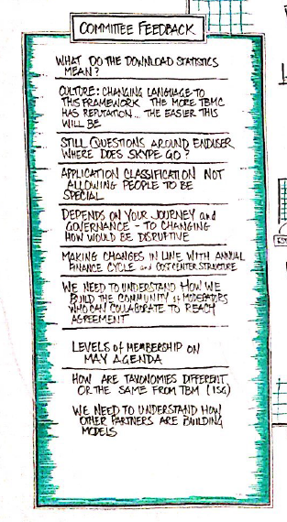
Taxonomy Evolution Sub-Committee Purpose
Members
Michel Brassart, DXC
Anthony Agent, Marriott
Brian Wolk, COX Automotive
Eric Merkle, MetLife
Kathy Rudy, ISG
Patrick Mulcare, GSA
Qi Chen, Fannie Mae
Ed Hayman, Apptio
Purpose
Evolve and improve the standard TBM Taxonomy
Goals
Encourage TBM practitioner input through TBM Connect
Collect and review TBM Taxonomy feedback on a regular basis
Recommend changes to the TBMC Standard Committee and TBMC Board for approval
Notes:
Type of changes included:
“MACD”
Moved some entries to different locations (such as Database & Middleware in the Towers)
Added new categories – including Internal Services in Cost Pools, Strategy & Planning along with Security & Compliance in the Delivery services.
Changed the name and meaning of several (such as Online & Offline Storage in the Towers, Virtual Compute and Containers in the Infrastructure services.
Deleted some entries to consolidate and simplify the structure (for example, in the Platform services which was collapsed to two categories – Data and Applications; in the Towers, removed Public Cloud and added as a level 3 categorization)
Additional input was provided in the overall definition of the various taxonomy entries as well as grammatical and other input to improve the overall readability of the taxonomy.

Slide 3
Taxonomy Evolution Focus for 2019
Define specific TBM Metrics beyond “CIO Top 10”
Support workgroups developing Business Services for verticals
Monitor feedback of published TBM Taxonomy
No planned updates to cost pools; IT towers; infrastructure, platform, delivery, end user or shared services

Slide 4
Feedback on TBM Metrics
Right approach and deliverables?
Right IT goals? Feedback on the definitions?
Right metrics? What is missing?
Notes:
Define vertical-specific business services for your work group

Slide 5
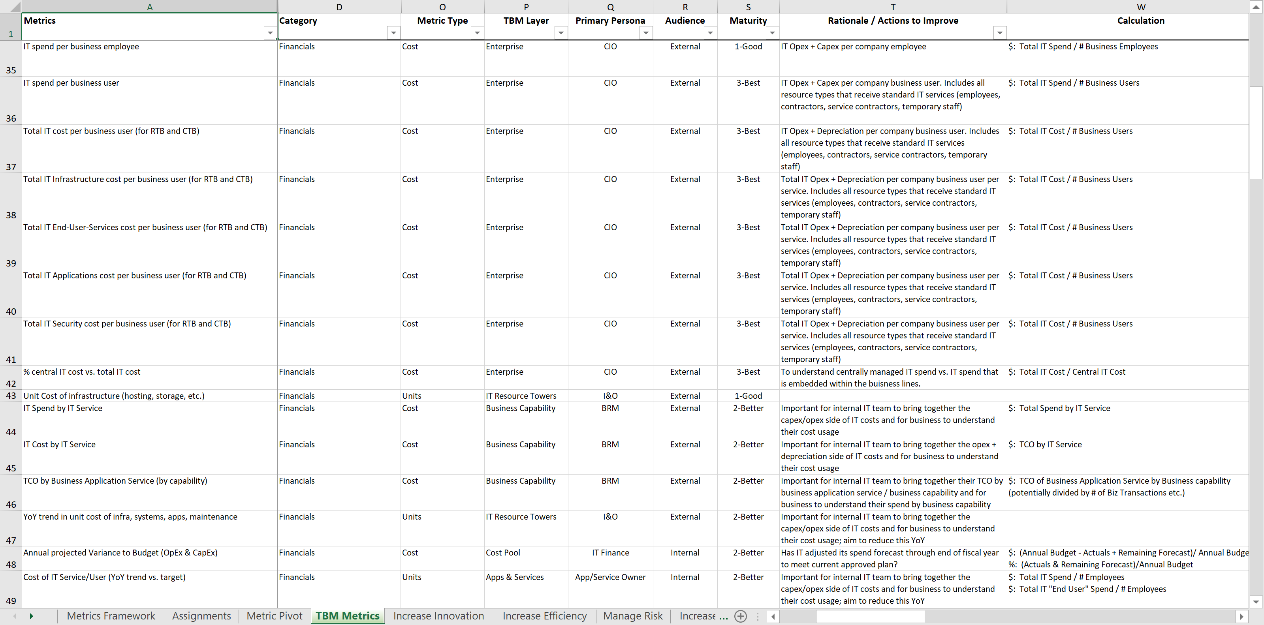
Detailed Spreadsheet of Metrics
127 Metrics
13 Columns
Complex!

Slide 6
Approach & Deliverables
Approach: Identify metrics to enable key IT goals
Deliverables
Business Goals enabled by IT
Define standard list
Recommended TBM Metrics per Goal
Identify top 5-7
Standard Metric Definition
Comprehensive definition of the metric (who, what, why, how)

Slide 7
Five Business Goals Enabled by IT
Goal | Definition
Increase Innovation (or increase revenue) | Deliver new emerging technologies or apply existing technology to enable new / enhanced capabilities that impact the business and drive differentiation, revenue and growth in the market.
Increase Efficiency (or increase profitability) | Increase efficiency in infrastructure (maximize utilization), employee (increase # units/employee), initiative, and cost perspectives to drive better profitability.
Increase Customer Satisfaction | Drive internal and external customer satisfaction with IT products. It can be extended to IT’s contribution to overall company satisfaction often captured through net promoter (NPS) scores.
Increase Speed to Market | Alternatively called “agility.” Measures how quickly an organization can deliver new features and/or functionality in existing or new products to its end users.
Manage Risk | Ability to measure and mitigate myriad types of risk; financial, sourcing, initiative, market, security, etc.

Slide 8
Increase Innovation
% of IT spend on Run/Grow/Transform
% of IT spend on R&D/emerging technologies
% of IT spend on new customer-facing technology
% of IT spend on business differentiating capabilities

Slide 9
Increase Efficiency
IT spend as % of revenue
IT spend per user
% of business processes with straight through processing
% of services achieving unit cost targets
% of IT service requests resolved through self service tools
% of user incidents resolved on first contact

Slide 10
Increase Customer Satisfaction
% of critical SLAs met
Minutes downtime for critical business systems
% of failed customer interactions followed up on
% of projects exceeding benefits
% of user incidents re-opened
External customer satisfaction score
Internal end-user satisfaction score

Slide 11
Increase Speed to Market
% of strategic IT suppliers with Business Outcome KPIs
% of IT spend on public cloud (IaaS, PaaS, SaaS)
% of projects delivered on time and on budget
% of IT resources on Agile teams

Slide 12
Manage Risk
Revenue lost to major incidents
# of security or data breaches requiring manual intervention
% annual IT budget variance
% of projects not adhering to technology standards
% headcount to plan
% of staff completing required training
% of assets <12 months until end-of-life
% of major software licenses in audit compliance

Slide 13
Standard Metric Definition
Concept | Purpose
Metric | Specific name of a metric.
Primary Persona | The role within IT who is primarily interested in the tracking and managing the metric.
Audience | Is the metric for internal IT use or shared with business consumers or users outside IT. Recommended categories: Internal, External
Maturity | Broad categorization of the org, process and data maturity required to track a specific metric.
Description | Description explaining the full meaning and purpose of the metric.
Rationale / Actions to Improve | The primary reason for tracking and managing the metric. Ideally speaks to the actions that would be taken if not in an expected range.
Frequency | How often the metric should be measured and reviewed and any targets adjusted.
Calculation | Specific formula to calculate the metric.
Data Required | Underlying data required to support the metric calculation. Should identify the source of where the data can be found.

Slide 14
Thank You!

