Slide 1
Information Technology Capabilities Contract (ITCC II)
Ryan Hopper
Program Manager
12 March 2020

Slide 2
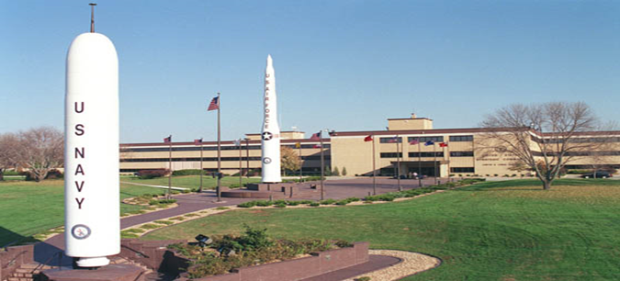
USSTRATCOM Missions/Facilities
ITCC II - Offutt Air Force Base (OAFB)
As USSTRATCOM’s outsourced IT Service provider we are committed to supporting USSTRATCOM’s mission capabilities by optimizing the delivery of quality IT services. ITCC II exercises maximum flexibility implementing IT initiatives to satisfy cost, schedule and performance parameters.
Virtualized desktop and application approach to deliver, protect, and manage Windows or Linux desktops and applications
Perform active cyber defense to discover, detect, analyze, and mitigate threats and vulnerabilities
Support mission system application development on a cloud-native DevOps platform
Brand new $1Billion headquarters on Offutt AFB
Mission:
Conduct global strike operations in coordination with other combatant commands, services, and appropriate U.S. government agencies to deter and detect strategic attacks against the U.S. and its allies, and is prepared to defend the nation as directed.

Slide 3
Location: Bellevue, Nebraska
Just South of Omaha
Low cost of living
Known as a “Foodie” town - tons of great local restaurants
2.9% unemployment (lowest in America for city size) - High IT, known as “Silicon Prairie”
7th best City for raising a family (top rated schools and best zoo in country)
Still a 20 minute town (can get basically anywhere in town under 20 minutes)
4th best state for housing affordability
Average home value is $150,000

Slide 4
Contract and Staffing
Contract
Currently in Option Year 3 of a 10 year contract, ~350 FTE
CPAR scores just in for CY 2019 are high
Staffing
Currently ~40 roles open between Perspecta and Teammates
Staff expanded as part of the C2F transition and growth is planned for OY4
Customer Service (desk, field, and logistics)
Cyber (net defense, engineering, ISSM)
Engineering (CM, network, project, requirements, test)
Operations (apps, database, end user provisioning, networks, UNIX, virtualization, windows)
Other: front office support, docs/records, metrics, audits, procurement, innovation
Majority of the program is cleared at TS/SCI
Openings
~40 roles between Perspecta and Teammates - go to the Perspecta career site (Bellevue, NE)

Slide 5
Transition Benefits
Mission - one of the best in the DoD
Stability - 7 more years on the contract
Clearance - upgrade to TS/SCI
Facilities - new modern building (C2F) and expanded Perspecta office
Location - Omaha and Eastern NE is a nice place to live
Career - growth opportunities on ITCC II

Slide 6
ITCC II Functional Organization Chart
Service Delivery Team
Program Management Team
Business Management
TBD
Program Manager
Deputy Program Manager
C2F
Cyber
Operations
TBD
Database & Application Eng and O&M
TBD
Engineering
Special Projects
Documentation
Lead
Contracts Manager
Cyber Security Engineering
ISSMs
Network Security
HBSS
Database Eng
Database Admin
Application Eng
Application Admin
EMMA
ERwin
Engineering
Testing
Change Management
Service Catalog
Release Management
Documentation/CAD
Dedicated Support
C2F Transition
TBD
Risk Management
Metrics and Reporting
Quality Lead
Training
Infrastructure Services
Manager
Gary Kruger
Customer Services Manager
Nate Jett
CCSS Red Switch Manager
Kevin Johnson
Specialized Support
TBD
Procurement
Finance
Networks
Servers
Storage/BUR
Tools Admin
Service Desk
Field Services
Windows Desktop Services
Warehouse/Logistics
Deployment
CCSS O&M
CCSS Cybersecurity
SW/HW Renewals
ITSMO/CSI
SACM
EVVMS
CCARS
CMSA – LANT
Voice and Video
Knowledge Management
TE2S
Invoicing3
Industrial Security
UNCLASSIFIED

Slide 7
Questions
?

