Slide 1
We will begin shortly.
We appreciate your patience…

Slide 2
TBM Council Standards Open Forum
November 9, 2022

Slide 3
Copyright ©2022 Technology Business Management Council, Ltd.
All rights reserved. Printed in USA. Technology Business Management Council Confidential Information.
The content in this presentation may not be copied, photocopied, reproduced, translated, or reduced to any electronic medium or machine-readable form, in whole or in part, without the express written consent of the Technology Business Management Council, Ltd.
The presentation and the content it contains is confidential and may not be distributed without the express written consent of the Technology Business Management Council, Ltd. The information contained in this presentation is subject to change without notice and does not represent a commitment on the part of the Technology Business Management Council, Ltd.
Notes:
Mention:
Mute etiquette – feel free to unmute yourself
Use Q/A

Slide 4
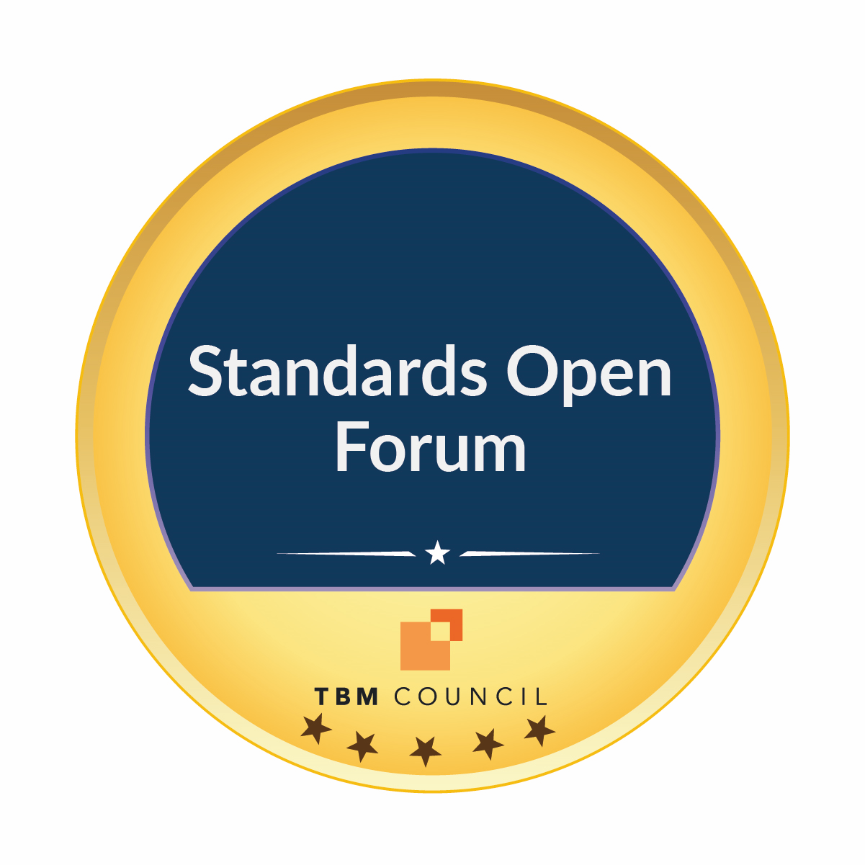
Leadership & Support TBM Standards Committee Members
Voting Members
Atticus Tysen, Intuit (Chair)
Akin Ayemobola, USAA
Brant Nyman, NCR
Carl Stumpf, Nike
Carollyn Gehrke, John Deere
Chris Curtis, Freddie Mac
Doug Copeland, Newport News Shipbuilding
John Wilson, MetLife
Kelley Wendelborn, Lowe's Companies
Lee Hawley, Red Hat
Matthew Erickson, Hub International Limited
Steve Morley, Intermountain Health
Non-Voting Members
Mina Han, REI Systems
Kathy Rudy, ISG
Stephanie Roe, State of Washington
Jon Sober, Author, Practical Technology Business Management
Laura Szakmary, US General Services Administration
Matt Temple, Accenture
JC Dewaele, Grant Thorton
Tim Pietro, Capgemini
Quinn Abraham, Maryville Consulting
Technical Advisor & Architect
Ed Hayman, TBM Council
Program Manager
Niketa Purandare, TBM Council
Notes:
Presenter: Lindsay
The Standards Committee, chaired by Atticus Tysen, SVP Product Development, Chief Information Security & Fraud Prevention Officer at Intuit, maintains and governs the TBM Taxonomy as well as the extensions and other deliverables created by the TBM Council Strategy Communities.
As part of our standardization initiatives, the TBM Council Standards Committee will be hosting a monthly Open Forum. The Open Forums are available to all Council members and encourage open dialogue and feedback on the topic presented – Welcome to today’s TBM Standards Open Forum held at the annual TBM Conference!

Slide 5
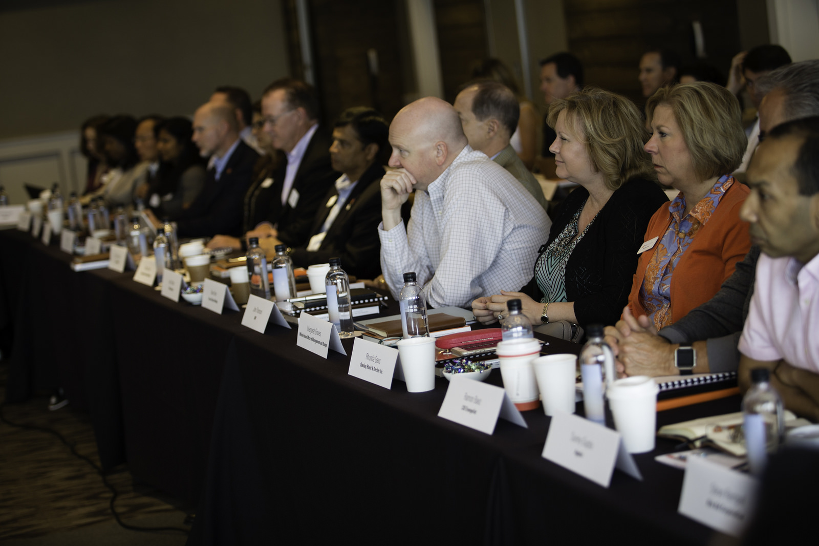
Join the TBM Council
Join online at http://www.tbmcouncil.org/join
Benefits include:
Connect with peers from our member community
Attend our annual global conference and regional events and networking groups
Access best practices and other resources on our community site
Take advantage of the TBM Council’s education offerings and certification program
Take pride in contributing to the rapidly growing discipline of Technology Business Management
Notes:
Become a member! http://www.tbmcouncil.org/join
Access to TBM Central Connect, our exclusive online community of IT/Finance leaders and CIOs who share their experience and knowledge on the growing TBM discipline
Access to conferences and summits, virtual and in-person events, industry-focused Strategy Communities, TBM Job Board, early access to research, and more!

Slide 6
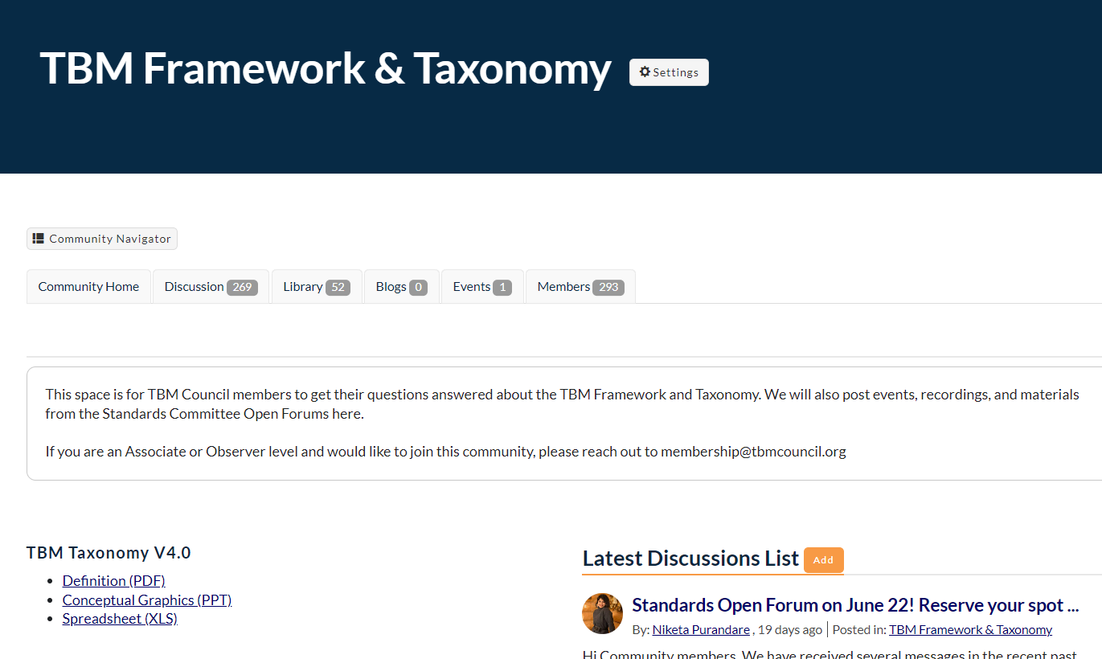
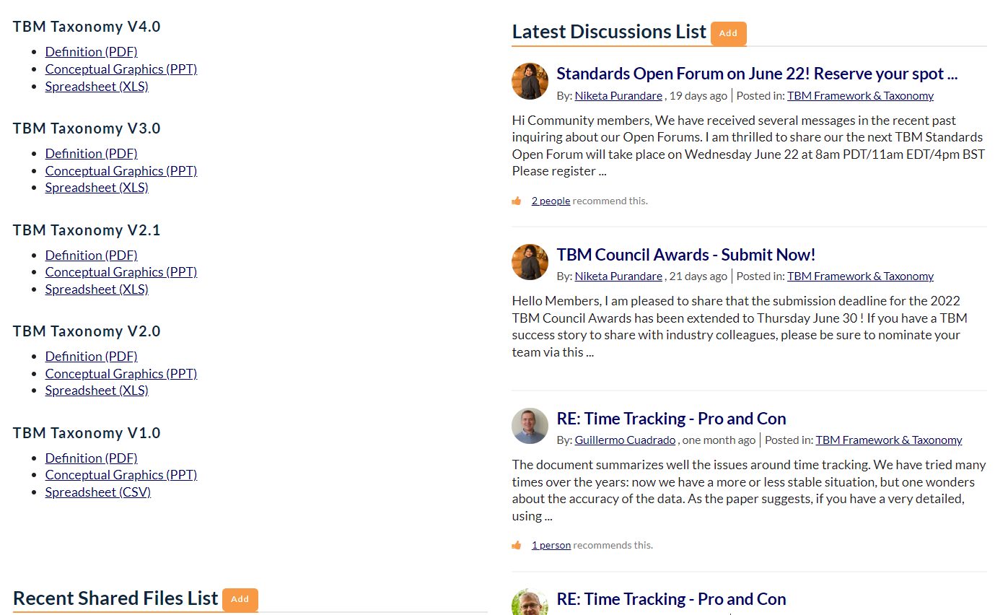
Be Sure to Engage Online
Join on TBM Connect to:
Access past meetings recordings and presentations
Engage with the 300+ other Strategy Community members
Receive invitations to future meetings
Stay up to date with Community discussions
Join the conversation on TBM Connect
Notes:
Presenter: Niketa
TBM Framework & taxonomy

Slide 7
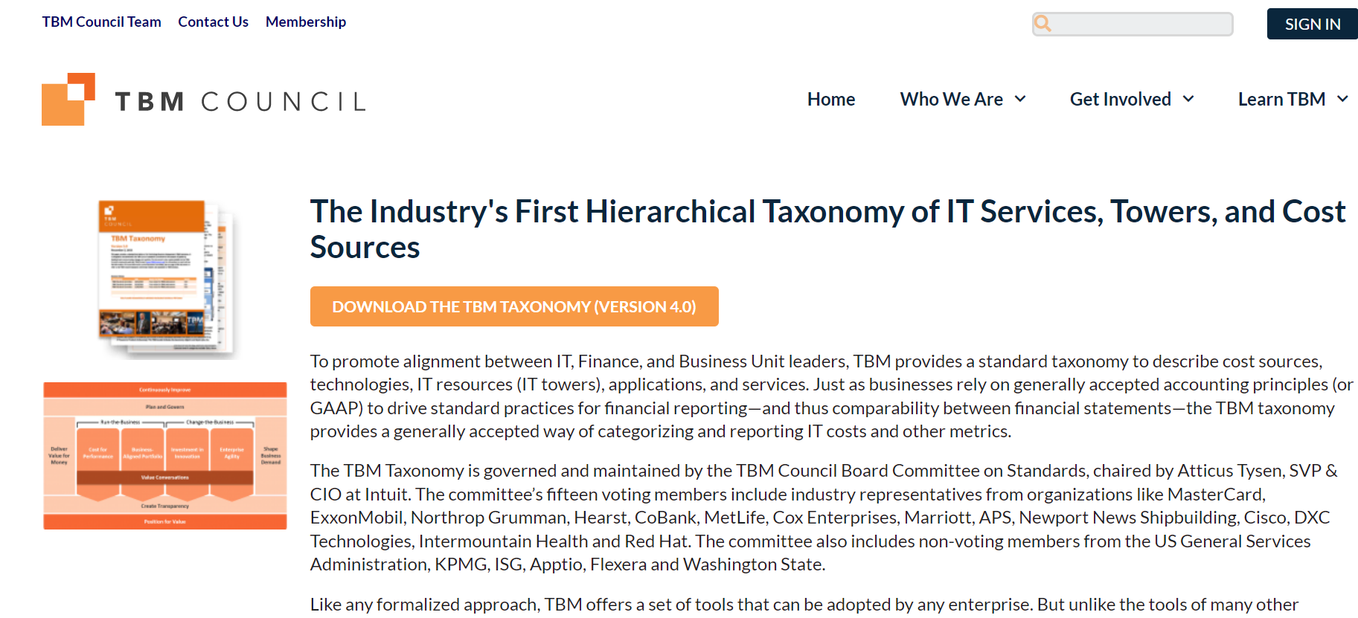
Improved Accessibility to TBM Taxonomy Materials
Bookmark Link!
https://www.tbmcouncil.org/learn-tbm/tbm-taxonomy/
Notes:
Presenter: Jasmine
Share link in comment box: https://www.tbmcouncil.org/learn-tbm/tbm-taxonomy/
We have an updated page to help with easy access of TBM Taxonomy and vertical extension materials. (Show a demo by sharing screen)

Slide 8
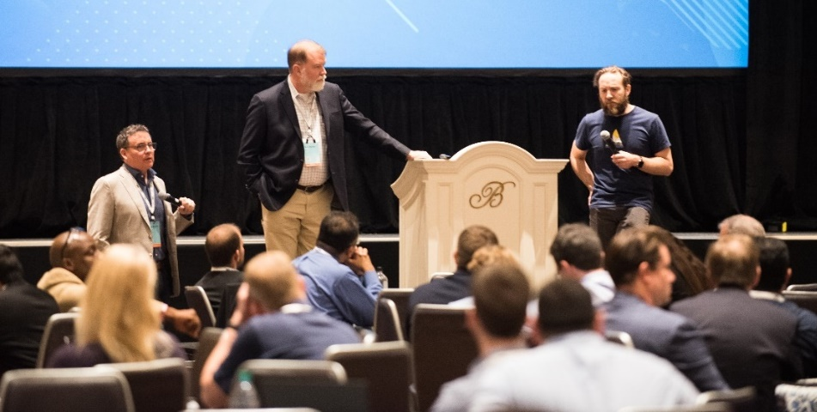
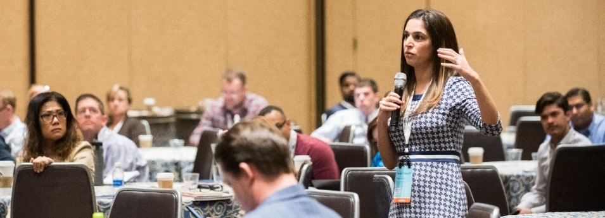
Topics for Today’s Session (45 mins)
0:00 – 0:05 | Welcome & Housekeeping Lindsay van Brocklin
0:05 – 0:40 | TBM Integration Models (15 mins)TBM & Agile by John Wilson, MetLife and Kelley Wendelborn, Lowe’s Companies Inc.
(15 mins)TBM & ServiceNow CSDM by Matt Temple, Accenture
0:40 – 0:45 | Q&A and Wrap-Up
Notes:
TBM-Agile followed by discussion (15 m)
TBM-ServiceNow CSDM followed by discussion (15)

Slide 9
TBM Integration Models: Agile & Product Thinking
John Wilson
VP, Technology Transformation, MetLife
Kelley Wendleborn
Sr. Manager of TBM, Lowe’s Companies Inc

Slide 10
Intersecting Disciplines – TBM, Agile, & Product Management
Complimenting Not Competing Constructs in Value Creation
Technical Business Management
Product Management
Agile
Increased transparency of technology financials and value delivery
Increased value delivery via persistency, iteration, enablement, & feedback
Increased customer value through holistic ownership over product lifecycle
Notes:
Presenter: John
Question on relevancy of these constructs.

Slide 11
TBM and Agile
Agile Delivery Fits Inside Technical Business Management
TBM includes the tower Application and sub-towers Application Development, and Application Support & Operations
Agile practices manifest as an alteration to how execution occurs within this space
Ex: How teams are organized, how work is planned and executed, etc.
TBM includes the tower Application and sub-towers Application Development, and Application Support & Operations
Agile practices manifest as an alteration to how execution occurs within this space
Ex: How teams are organized, how work is planned and executed, etc.
Note:
Agility can inherently change unitization, budget, forecast, internal billing, and/or benchmark
These adjustments can be addressed much like other offerings within the taxonomy
!
Note:
Agility can inherently change unitization, budget, forecast, internal billing, and/or benchmark
These adjustments can be addressed much like other offerings within the taxonomy
!
Notes:
Presenter: John Wilson

Slide 12
TBM and Product Management
Technical Business Management Fits Inside Product Management
Product Management, seeking to increase value through holistic management, includes Technology often as a subset
TBM can enhance awareness of financial and value delivery for the associated Technology
Customer
Technology
Business
Business
Strategy
Delivery
Marketing
Sales
Customer Service
Finance
Note:
Product Management has varying definitions in industry (ex: go-to-market vs internal products)
Regardless of context, intent usually aligns on broadening context and increasing accountability
!
Notes:
Presenter: Kelley
Where are you in your product journey?
Not product oriented
Determining our products
Establishi

Slide 13
In Conclusion…of an Intro
Usage of One Discipline is not a Deterrent for Entrant to Another
While language, constructs, and intents can vary…
TBM, Agile, and Product Management can make for a complimentary management tool kit
Agile Delivery
Technical Business Management
Product Management
Note:
“Words have a magical power. They can either bring the greatest happiness or the deepest despair.” – Freud
Different frameworks will use different vocabulary – prioritize internal alignment over industry alignment
!
Notes:
Presenter: close out organically

Slide 14
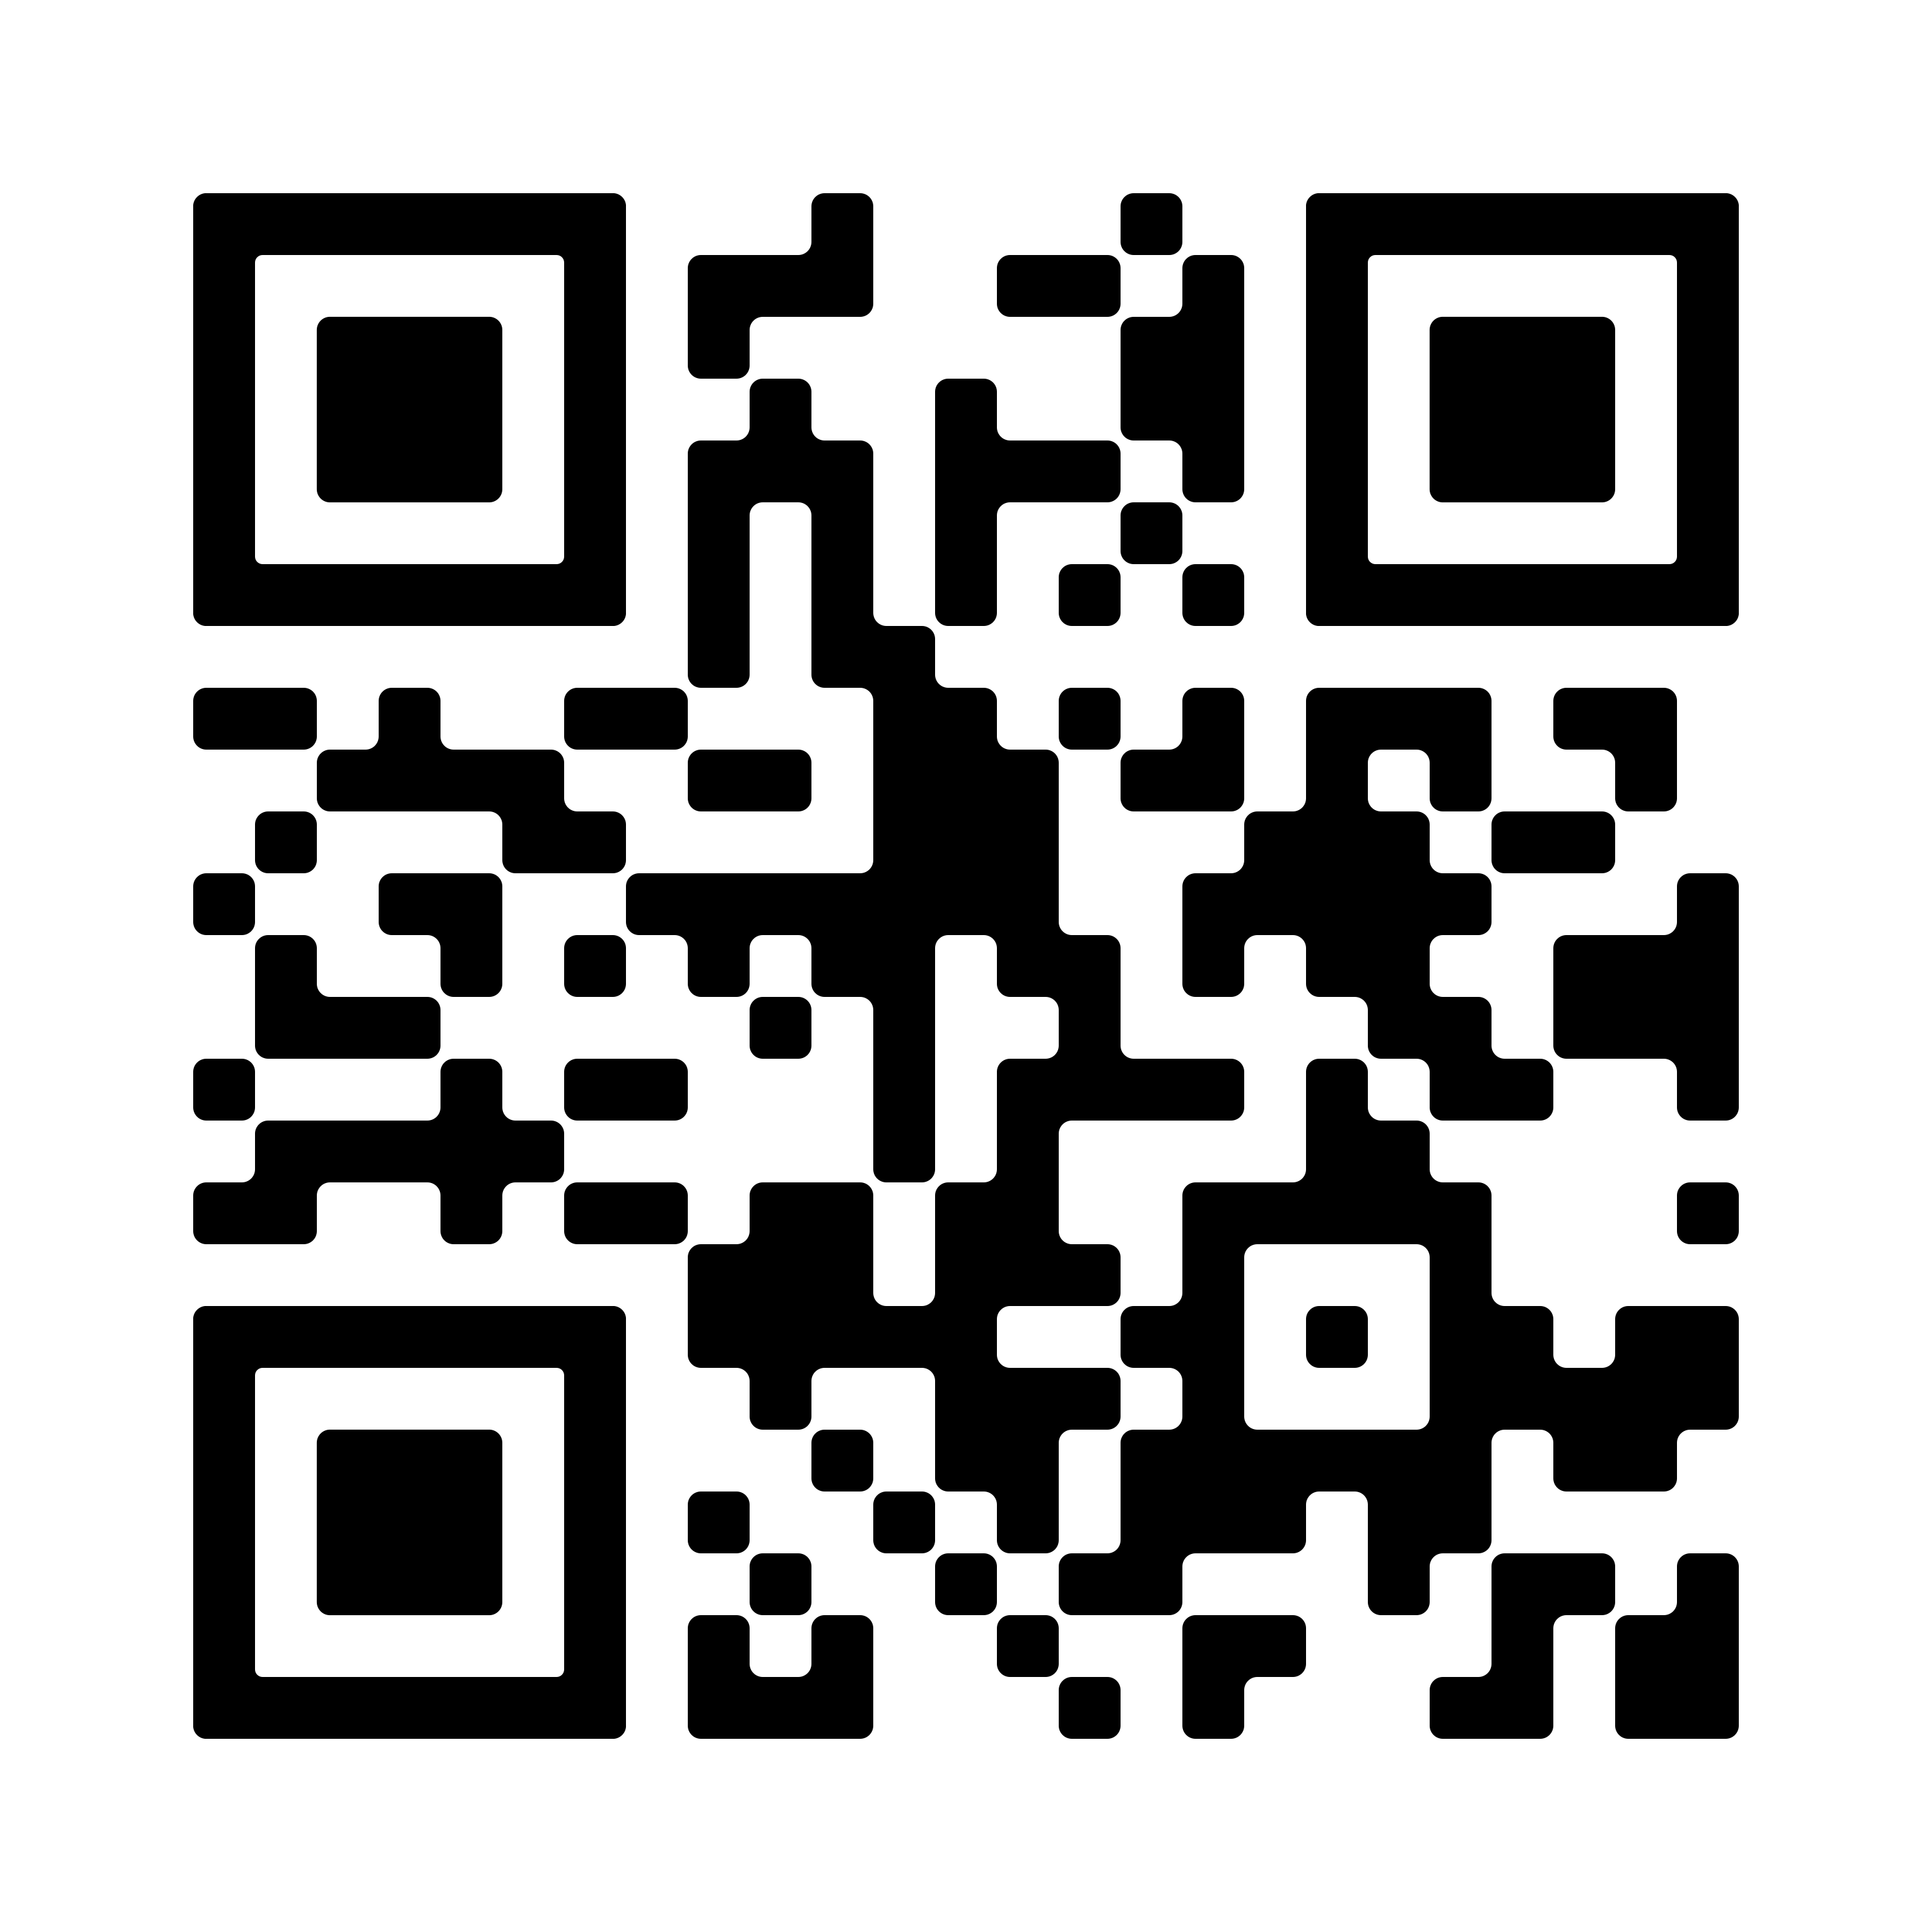
TBM Integration Model: Agile & Product Thinking
Now available online:
Available on the TBM Council Resource Center.
TBM Council members also have access to this infographic through TBM Connect. Visit the ”TBM Framework & Taxonomy” community.
Scan the QR Code to view the full infographic

Slide 15
TBM Integration Model: ServiceNow CSDM
Matt Temple
Transformation Excellence Manager, Accenture

Slide 16
CSDM Evolution
- “ServiceNow CSDM: Evolution & CSDM Examples.” The DCM Blog, Qualdatrix Ltd, https://datacontentmanager.com/servicenow-csdm-example-data-models.

Slide 17
Common Service Data Model (CSDM)
A standard and shared set of service-related definitions across ServiceNow products and platform that will enable and support true service level reporting while providing prescriptive guidance on service modeling within the CMDB.
The data model is a CMDB framework across ServiceNow products and platform that will enable and support multiple configuration strategies.
- Lemm, Scott. “CSDM 4.0 Draft White Paper.” ServiceNow, 18 Jan. 2022.

Slide 18
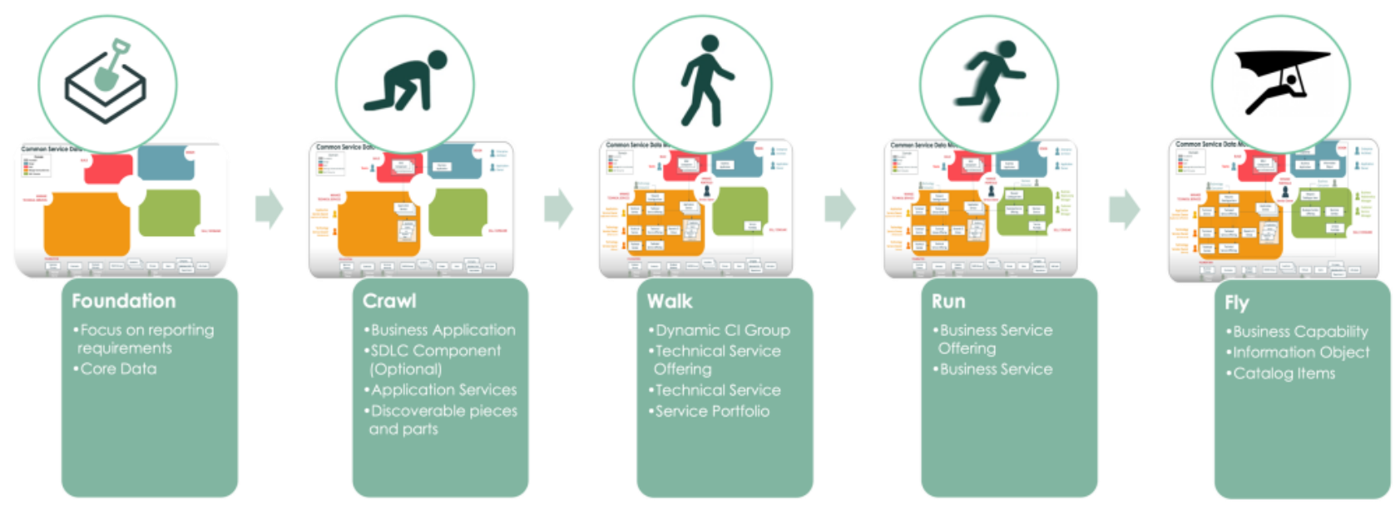
Which phase are you in?

Slide 19
TBM Standard Model
TBM is a value-management framework instituted by CIOs, CTOs, and other technology leaders.
TBM provides a standard taxonomy to describe cost sources, technologies, IT resources, and solutions.
The taxonomy provides the ability to compare technologies, resources, and solutions to peers and third-party options.

Slide 20
ServiceNow’s Suggested Mapping
- Bodman, Mark. “CSDM V3 Framework Mapping: TBM Council 3.02.” YouTube, ServiceNow, 9 Apr. 2021, https://www.youtube.com/watch?v=I1zjjmh6xt8.

Slide 21
Primary Integration Areas

Slide 22
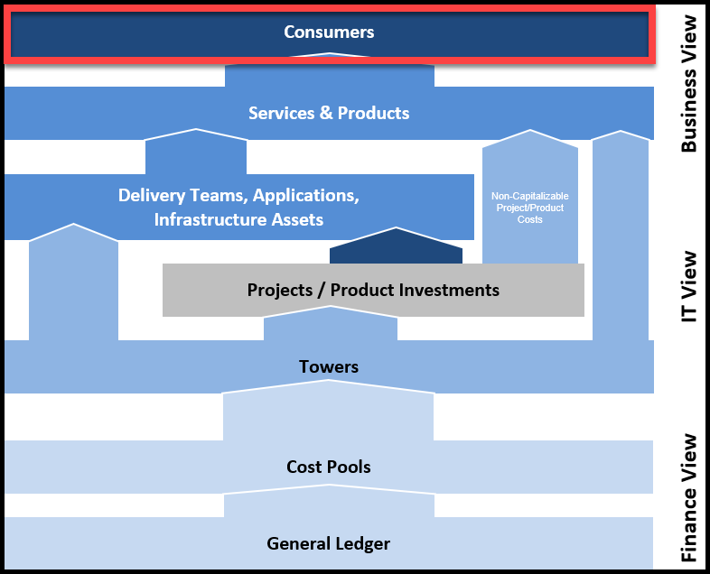
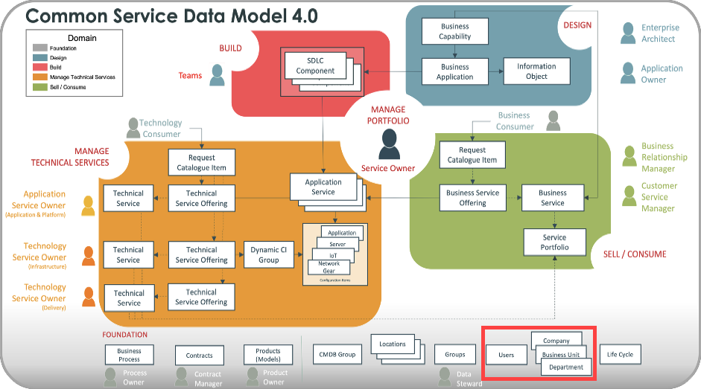
Consumers
TBM | SNow CSDM: CMDB Table
Consumer (attributes) | Company: core_company Business Unit: business_unit Department: cmn_department Users: sys_user
NOTE: A Foundation element (eg Company, Users, Locations, Life Cycle) can be related to most, if not all, elements in any other domain.
RECOMMENDATION #1: In your TBM tool, enhance the data obtained for Company, Business Unit, Department, Users, and other Foundation elements with data pulled from other systems of record (eg Workday, SAP, Oracle Financials, Active Directory). Frequently, a ServiceNow CMDB’s Foundation data is limited to information it needs to function and excludes information required for TBM success.
- “Common Service Data Model Domains.” ServiceNow Product Documentation, ServiceNow, https://docs.servicenow.com/bundle/tokyo-servicenow-platform/page/product/csdm-implementation/concept/csdm-domains.html.

Slide 23
What is a Solution?
A Solution is a generic reference to a Service or a Product.
Service is the means of delivering value to customers by facilitating outcomes customers want to achieve without ownership of specific costs and risks nor awareness of underlying resources and processes needed. Services can comprise of none, one, or many Applications and/or other Services.
Product is alternative label used for a Service. Typically, Product is used exclusively by Agile teams and IT organizations organized as a DevOps practice. A Product is not equivalent to an Application nor Application Family. See Service for further information.

Slide 24
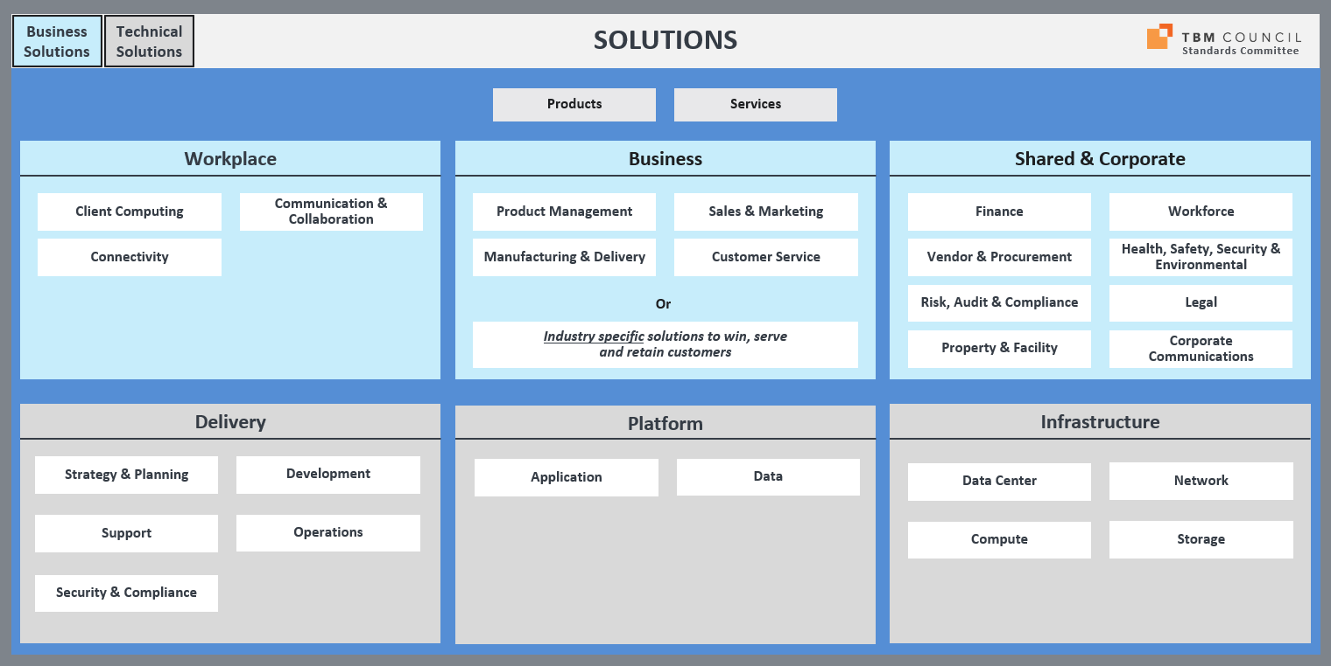
Have you adopted the TBM Solutions Taxonomy?

Slide 25
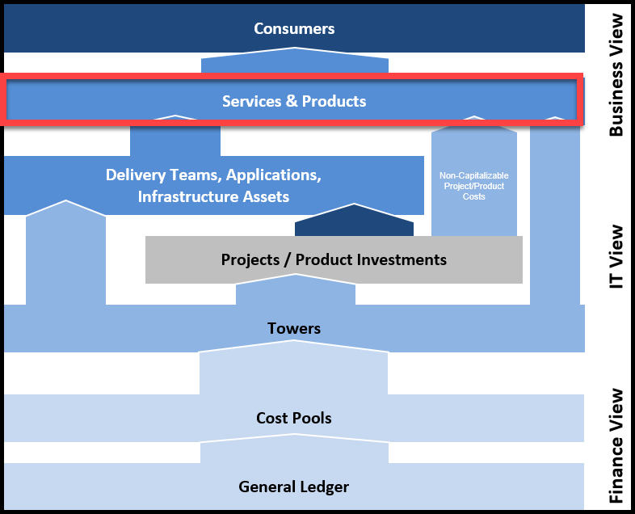
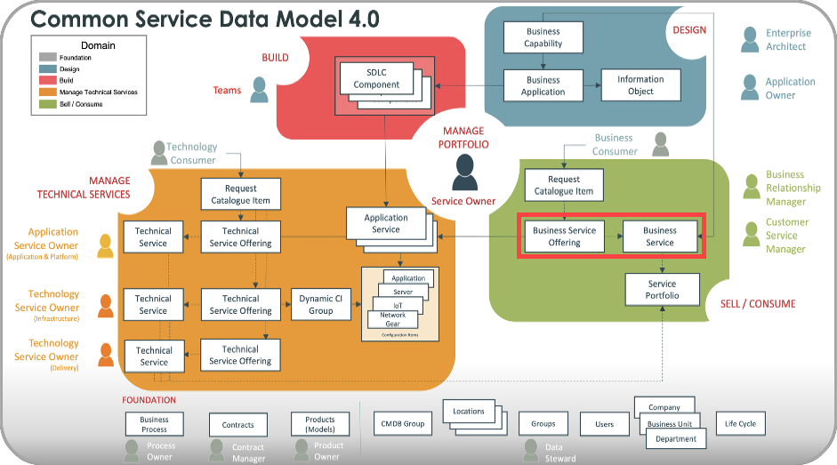
Business Solutions
TBM | SNow CSDM: CMDB Table
Solution Offering | Business Service Offering: service_offering Service Classification = “Business Service”
Solution Name | Business Service: cmdb_ci_service
RECOMMENDATION #2: Use the standard TBM Solution’s Name (tier 3) values belonging to the Business, Workplace, and Shared & Corporate Solution Types (tier 1) to establish initial values for the CMDB’s Business Service table.
- “Common Service Data Model Domains.” ServiceNow Product Documentation, ServiceNow, https://docs.servicenow.com/bundle/tokyo-servicenow-platform/page/product/csdm-implementation/concept/csdm-domains.html.

Slide 26
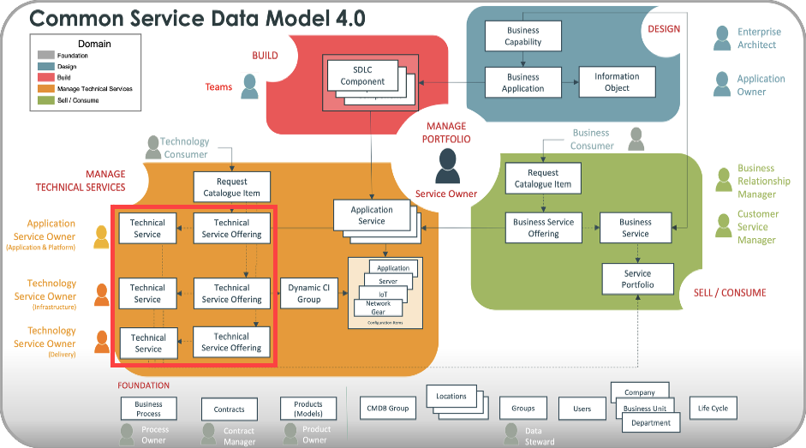
Technical Solutions
TBM | SNow CSDM: CMDB Table
Solution Offering | Technical Service Offering: service_offering Service Classification = “Technical Service”
Solution Name | Technical Service: cmdb_ci_service_technical
NOTE: A Foundation element (eg Company, Users, Locations, Life Cycle) can be related to most, if not all, elements in any other domain.
RECOMMENDATION #3: Use the standard TBM Solution’s Name (tier 3) values belonging to the Delivery, Platform, and Infrastructure Solution Types (tier 1) to establish initial values for the CMDB’s Business Service table.
- “Common Service Data Model Domains.” ServiceNow Product Documentation, ServiceNow, https://docs.servicenow.com/bundle/tokyo-servicenow-platform/page/product/csdm-implementation/concept/csdm-domains.html.

Slide 27
Recommendation #4
Expand the TBM Solutions Taxonomy to meet your organization’s needs.
Guidelines:
After exhausting existing options, expand the Name (tier 3) level.
Offering (tier 4) is 100% custom, so add as many offerings as needed.

Slide 28
Recommendation #5
Adopting, will adopt, or fully embraced using products…
Register products and services into Technical/Business Service Offerings.
In Technical/Business Service Offering records’ schema and your TBM Solutions Taxonomy’s Offering (tier 1), add a Sub-Classification (or Offering Type) attribute to define the record as a “Product” or a “Service”.

Slide 29
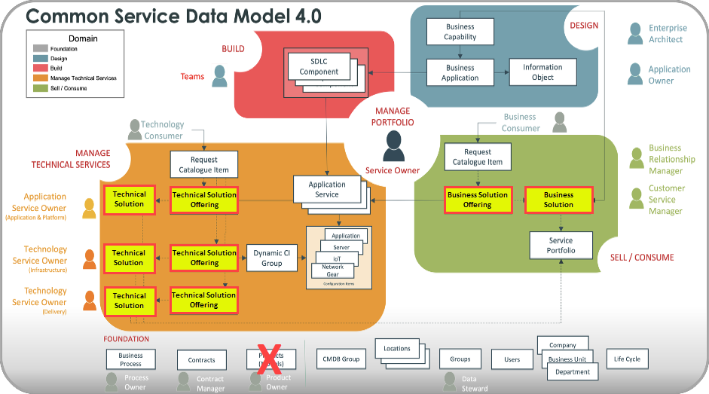
CSDM Viewed with “Solutions”

Slide 30
What is an Application?
Identifiable software or tightly coupled software components providing functions required by a Solution (eg Service, Product).
An Application may be part of one or more Solutions, but can only be associated to one Application Family.
An Application is ran or hosted on one or more Servers or Clients (including Cloud instances).
NOTE: An Application is not equivalent to a Solution, but can be a component of a Solution of the same name.

Slide 31
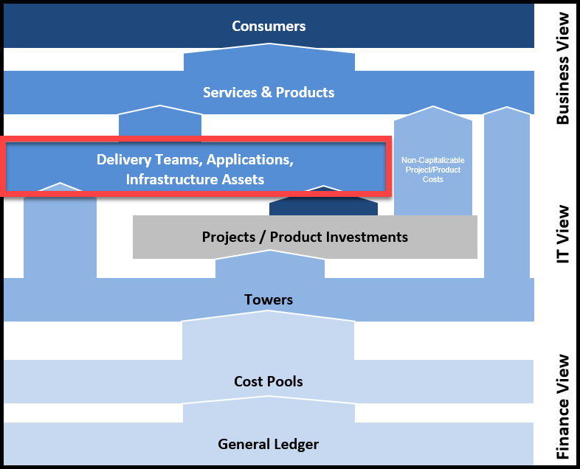
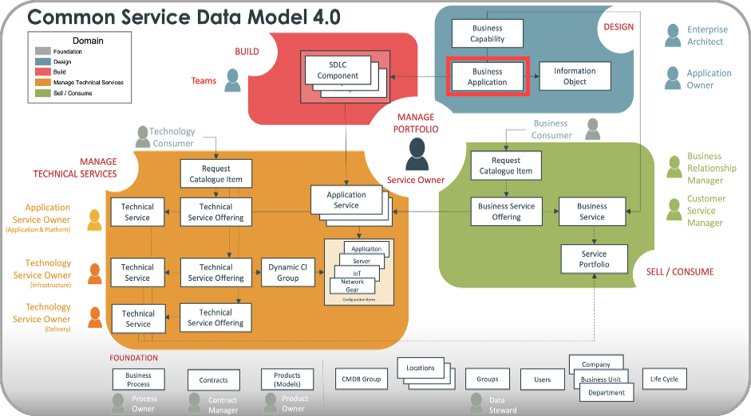
Applications
TBM | SNow CSDM: CMDB Table
Application | Business Application: cmdb_ci_business_app
ADDITIONAL NOTES
Although “Business” appears in the name the table should include logical representations of all applications in the organization’s application registry or ServiceNow’s APM, if in use. The reference to “Business” is applied to the whole organization (inclusive of Technology).
Do not use data from the cmdb_ci_appl table when collecting a list of applications for your organization. Each record in the cmdb_ci_apple table, per ServiceNow’s CSDM product documentation, represents a specific version of software in use installed on a server…not a logical representation of an application.
- “Common Service Data Model product view Application Portfolio Management.” ServiceNow Product Documentation, ServiceNow, https://docs.servicenow.com/en-US/bundle/tokyo-servicenow-platform/page/product/csdm-implementation/reference/apm-use-case.html.

Slide 32
Recommendation #6
Treat Applications as part of the Infrastructure domain not part of the Solutions Taxonomy (where Services and Products are found).
“You can decommission the application, but the service may live on!” - TBM Scientist

Slide 33
Recommendation #7
Retain your product hierarchy, if established, and map your products into the TBM Solutions Taxonomy.

Slide 34
Infrastructure Assets
TBM | SNow CSDM: CMDB Table
Data Center | cmdb_ci_datacenter
Network | cmdb_ci_netgear
Storage | cmdb_ci_storage_device cmdb_ci_storage_server cmdb_ci_storage_volume
Mainframe | cmdb_ci_mainframe cmdb_ci_mainframe_lpar
Servers | cmdb_ci_server
Database | cmdb_ci_database cmdb_ci_db_instance
NOTE: Review documentation for your TBM/IFM tool or, if using Apptio tools, review Help documentation titled “Datalink ServiceNow Ingress connector” for more information.
- “Common Service Data Model Domains.” ServiceNow Product Documentation, ServiceNow, https://docs.servicenow.com/bundle/tokyo-servicenow-platform/page/product/csdm-implementation/concept/csdm-domains.html.

Slide 35
Success of TBM depends on the success of existing systems of record.
Likewise, existing systems are substantially improved by adopting TBM practices.

Slide 36
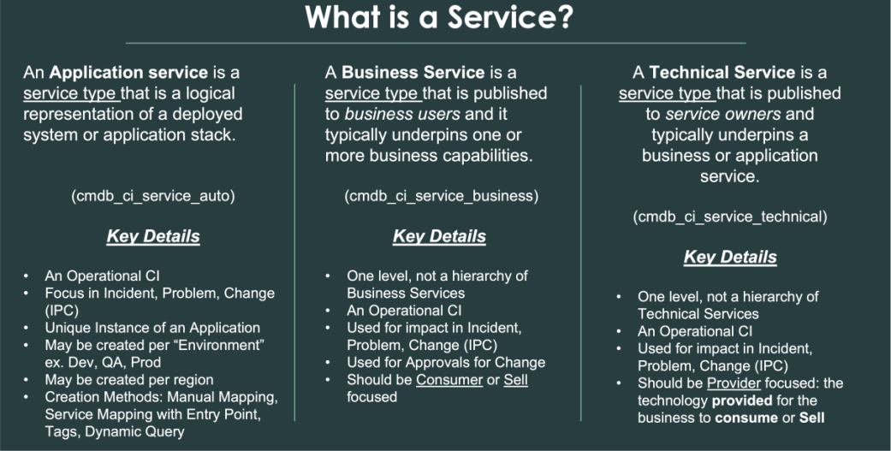
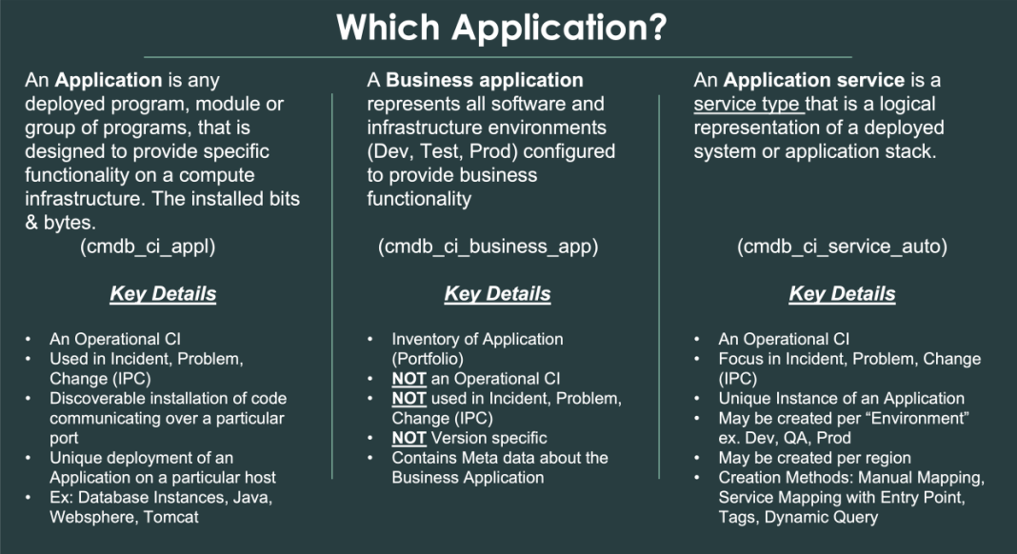
ServiceNow Definitions
- Lemm, Scott. “CSDM 4.0 Draft White Paper.” ServiceNow, 18 Jan. 2022.

Slide 37
- Bodman, Mark. “Office Hour 52 – APM: CSDM v4.0 and APM.” YouTube, ServiceNow, 13 Jun. 2022, https://www.youtube.com/watch?v=6MrekggoQ4A.

Slide 38
Thank you for joining today!

